Slide 1
Inventory Management
This product is for manage your inventory.
I created this product for water-purifier company.
You can add/Update product,supplier,Client.
You can view all inventory report.
Technology used.
Backend:Asp.net
Database:Mysql
Design:Html,Css,Js,Bootstrap

Slide 2
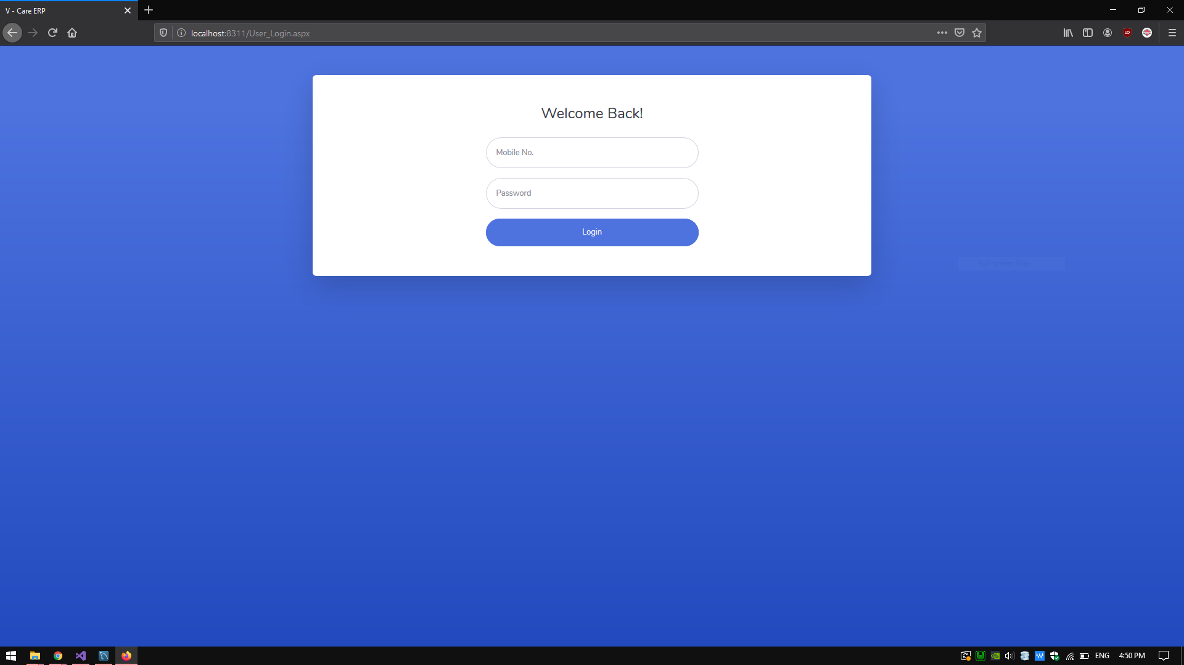
User login
Username: 9999999999
Password : 1234

Slide 3
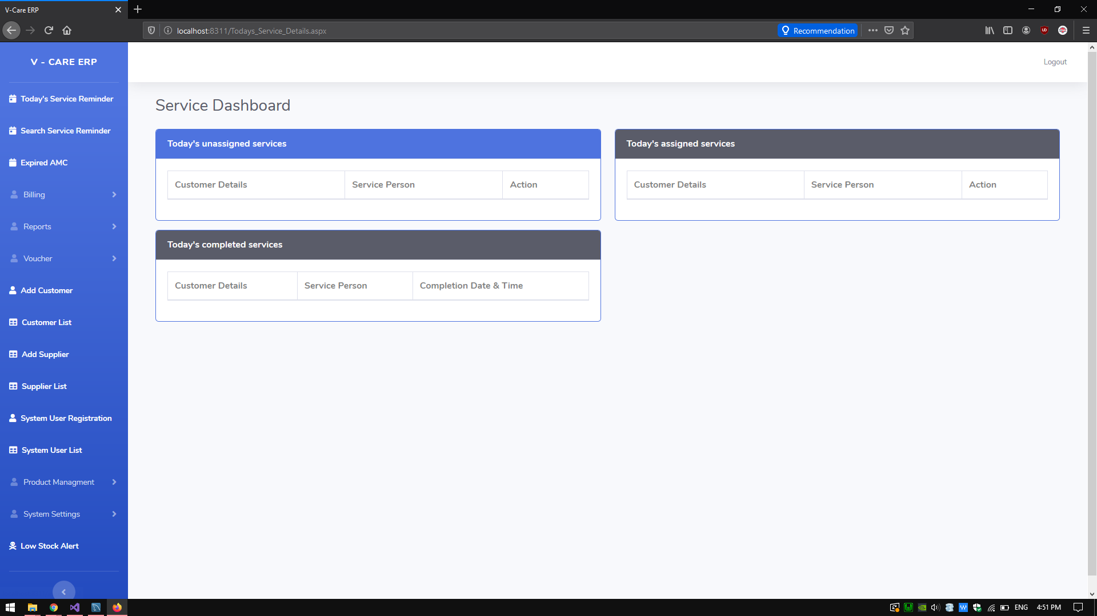
Page after login!

Slide 4
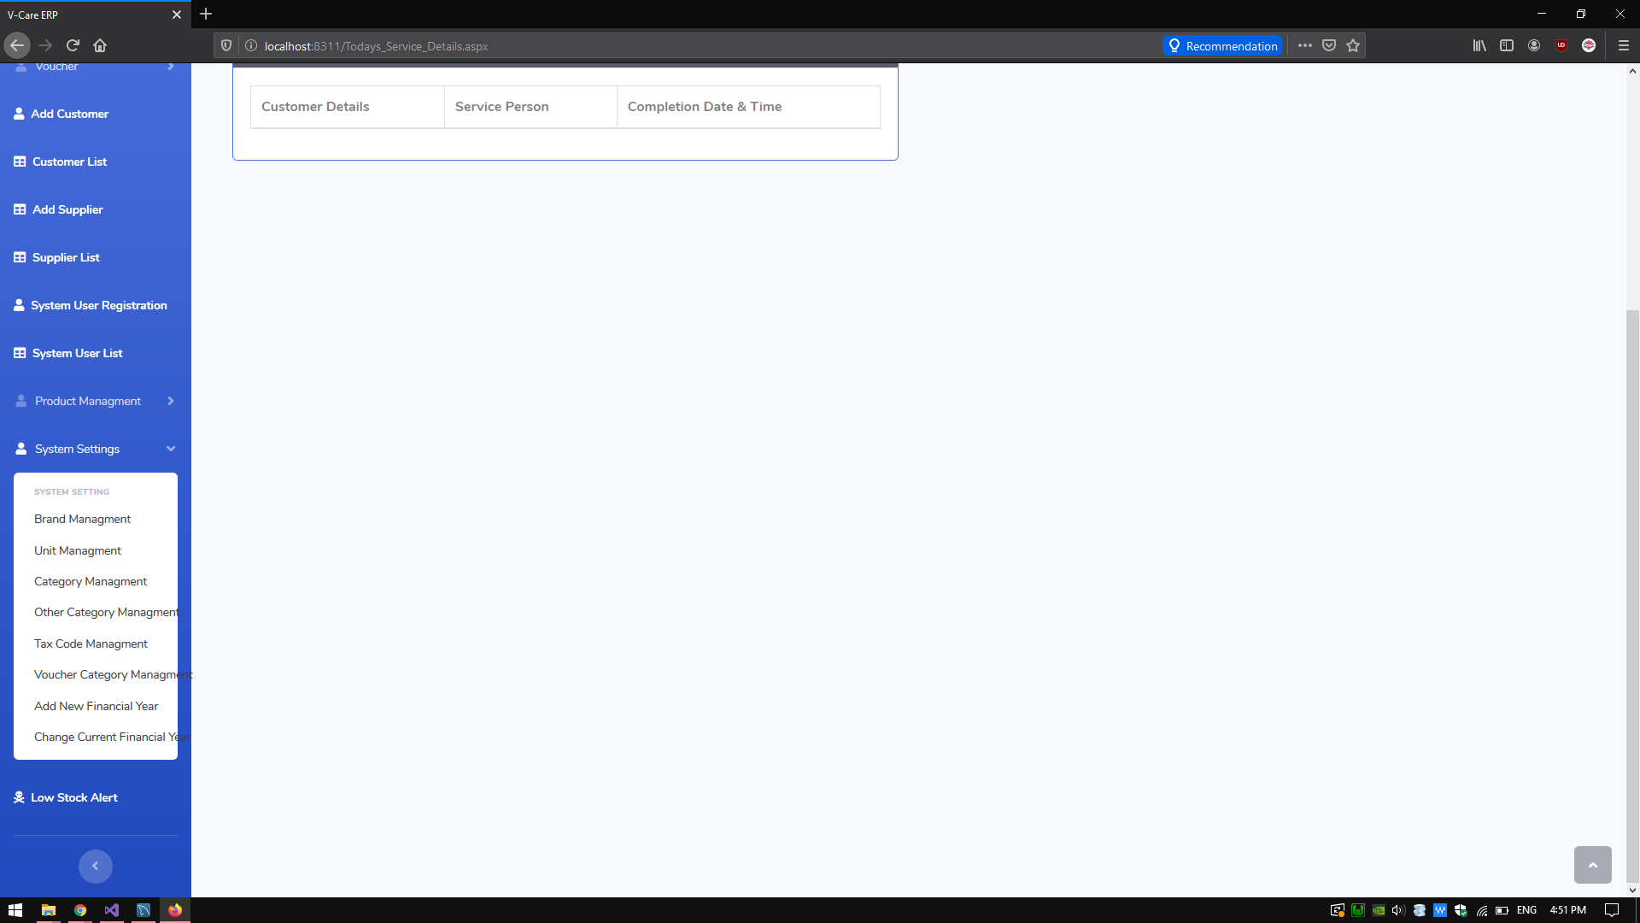
System Setting
From system setting you can insert brand,unit,category and all.

Slide 5
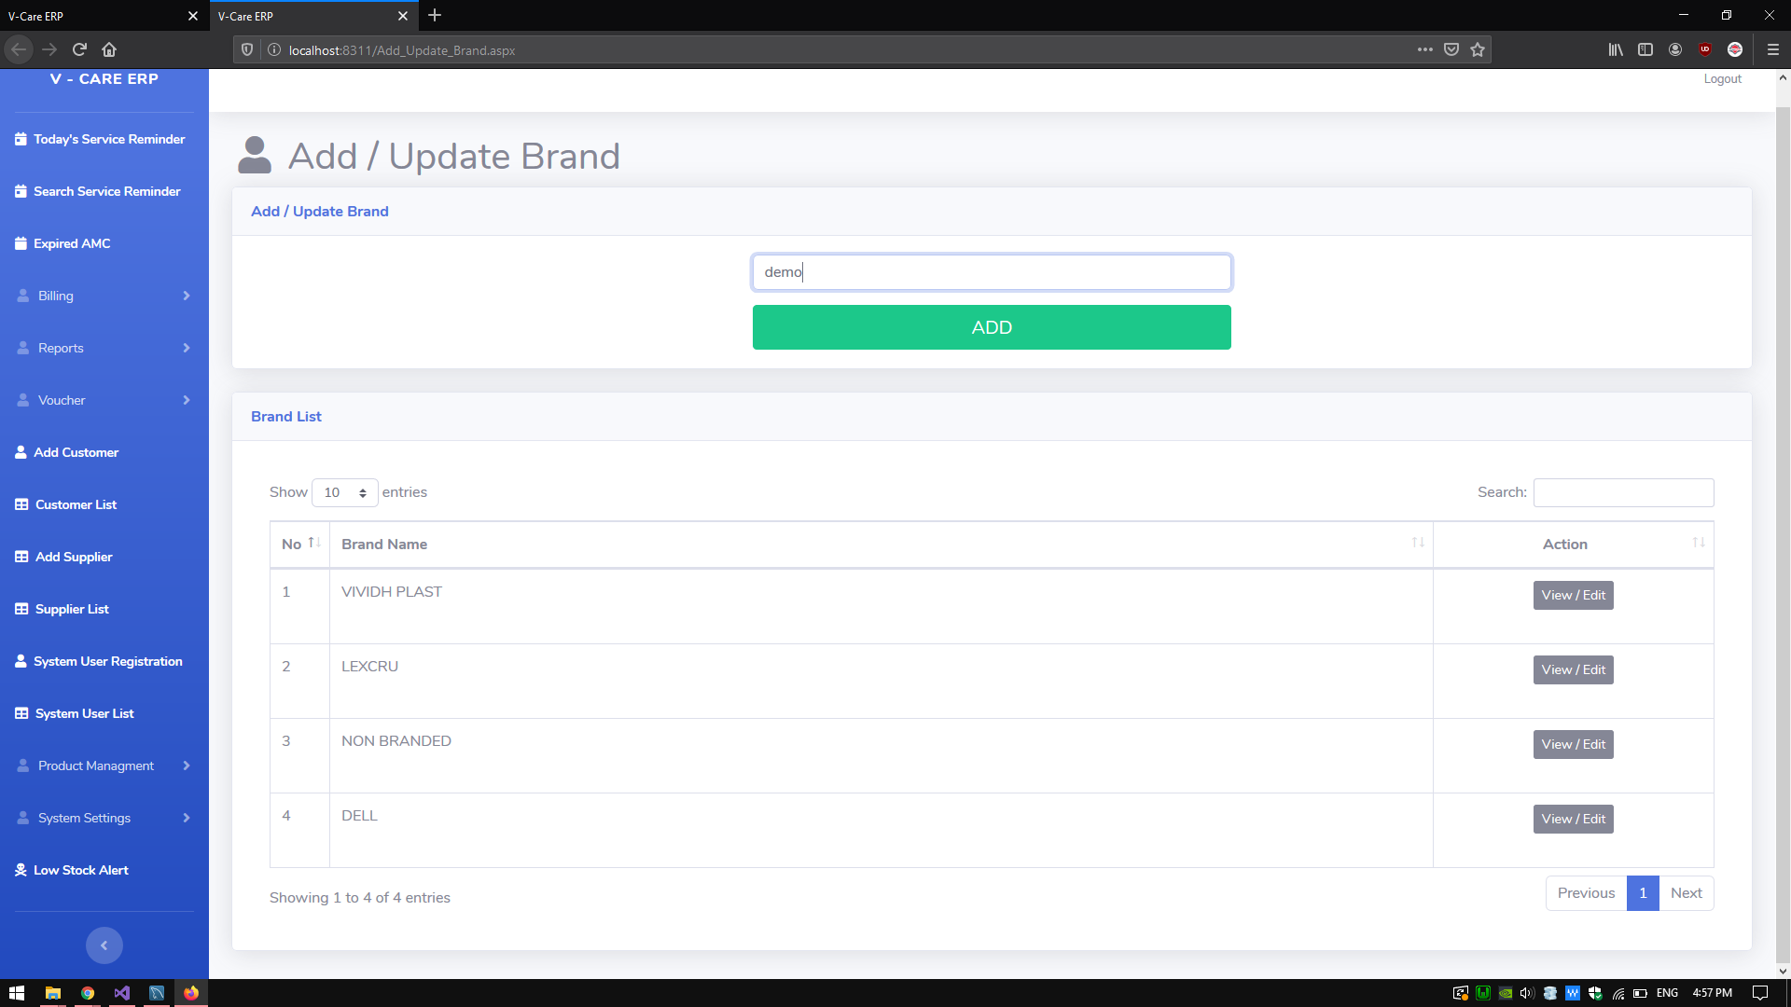
Add/Update Brand
You can add new brands and update old brand name from action button.

Slide 6
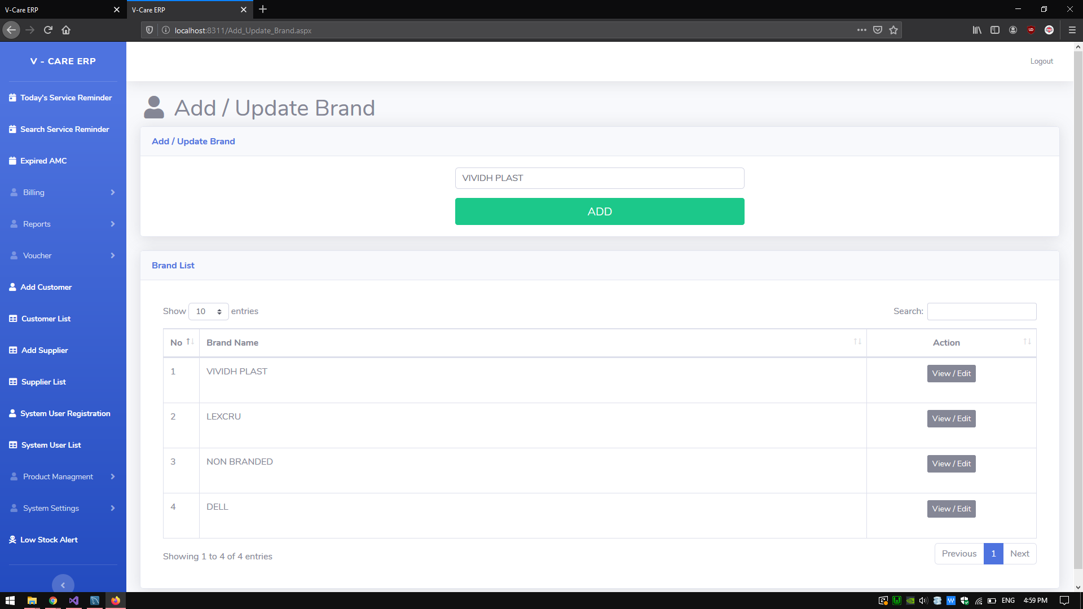

Slide 7
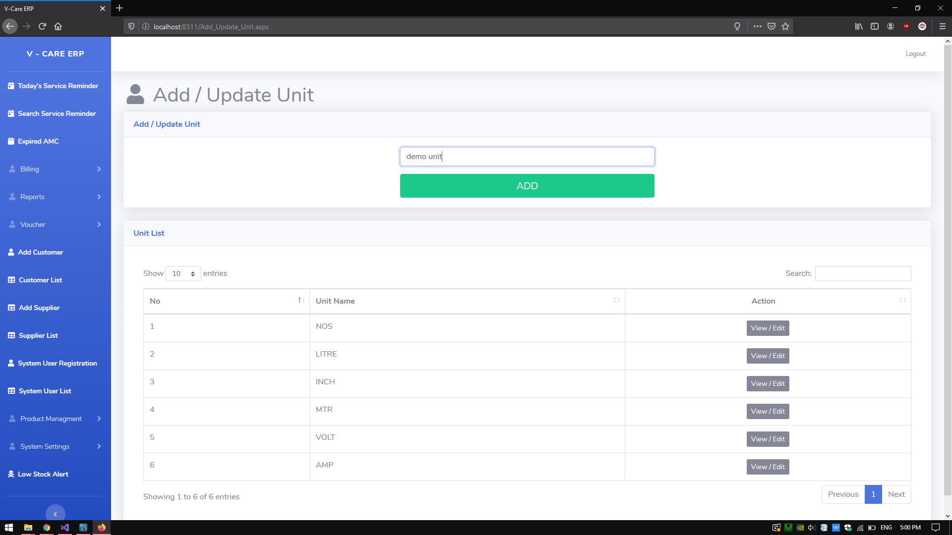
Add/update unit

Slide 8
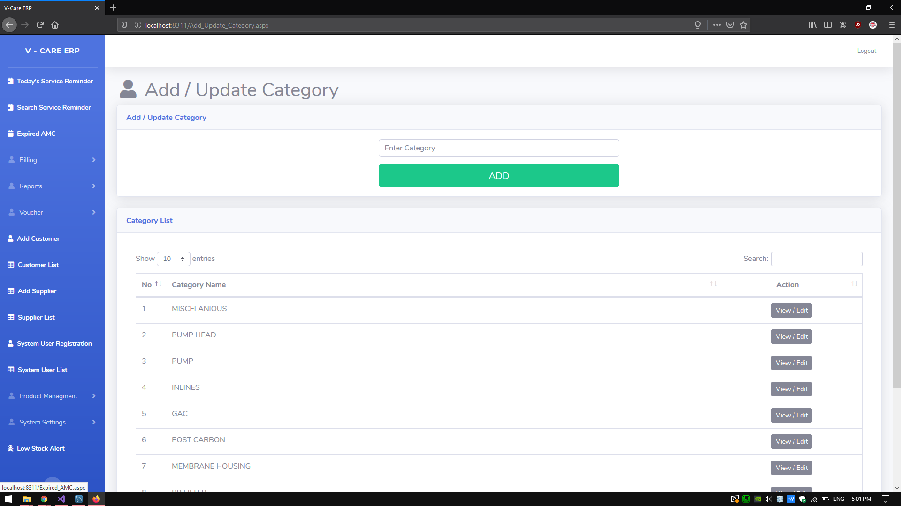
Enter category of product

Slide 9
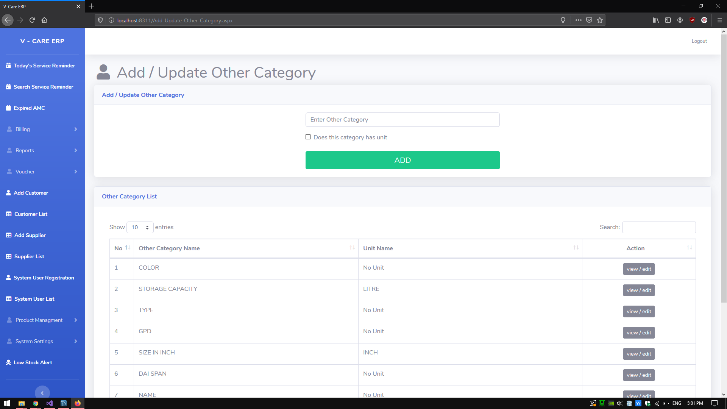
Enter sub category without unit

Slide 10
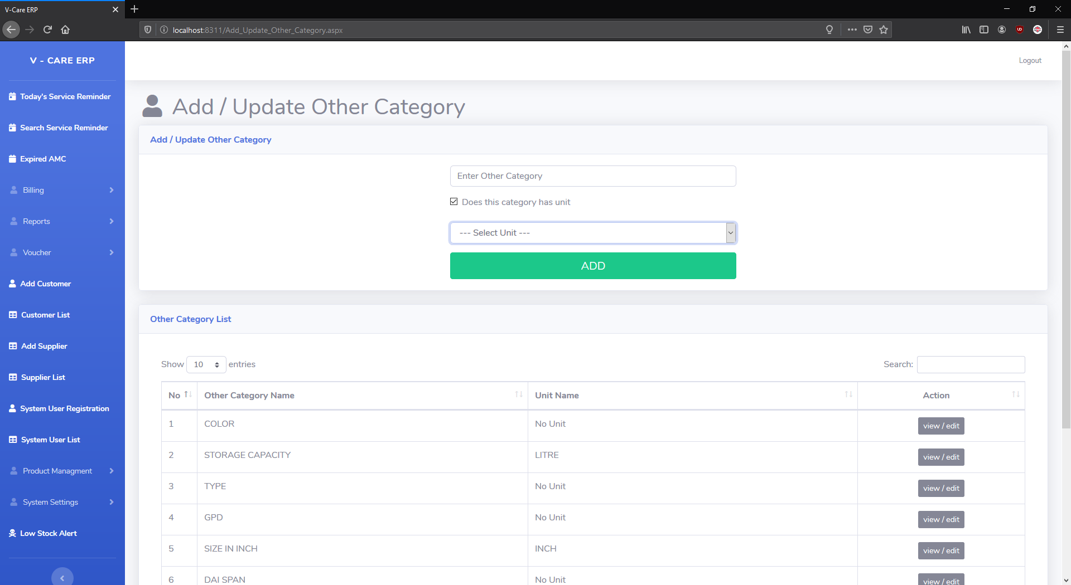
Enter other category without unit
If other category has unit then select check box.

Slide 11
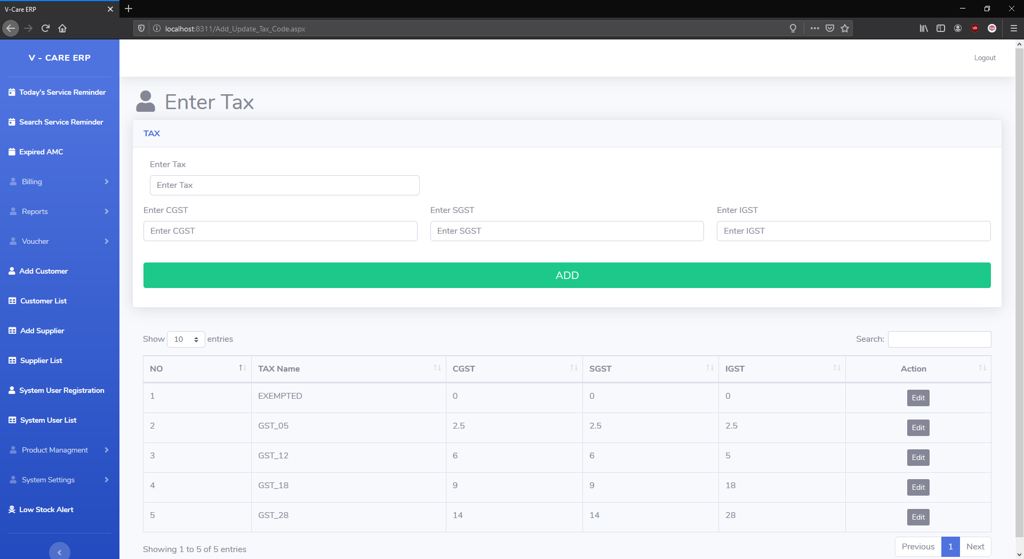
Enter Tax

Slide 12
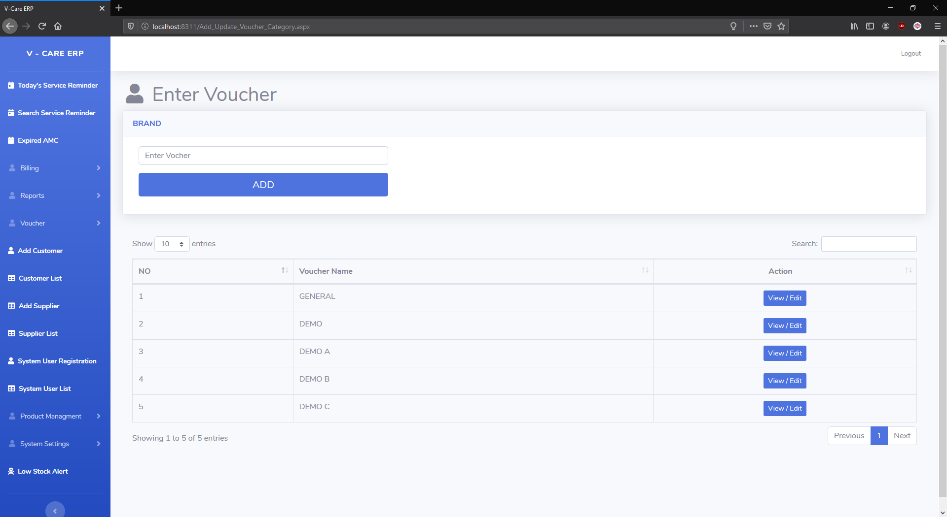
Enter name of the voucher.

Slide 13
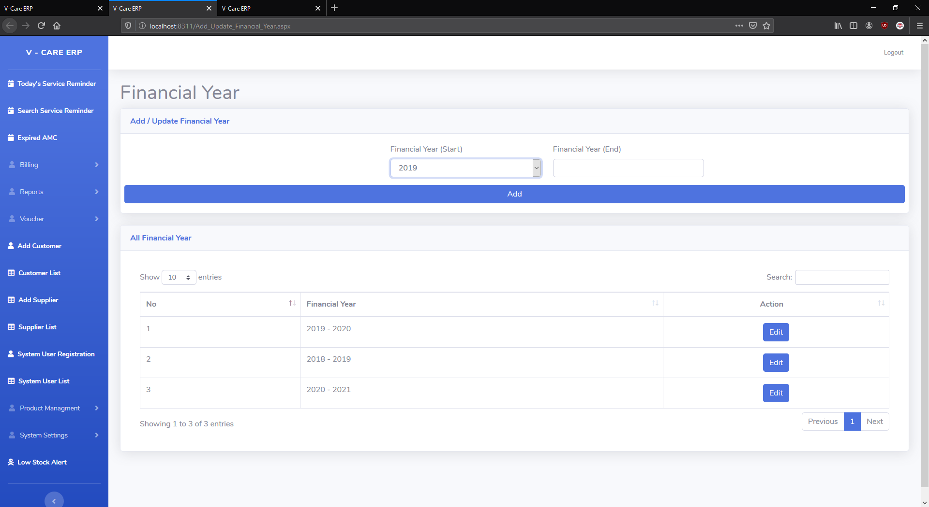
Add update financial year.
you just have to select "start" financial year ,"end" financial year will choose automatically.

Slide 14
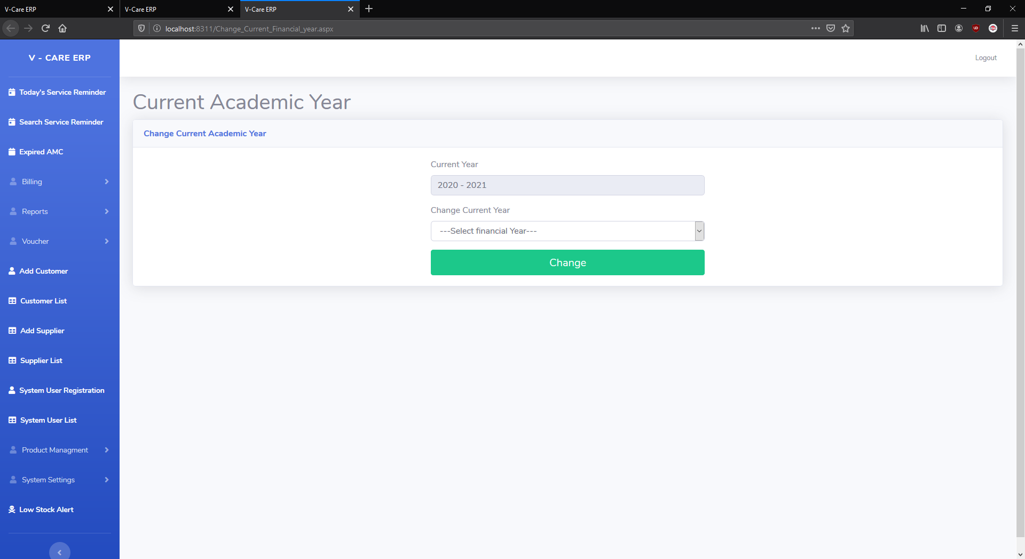
Change financial year

Slide 15
Where you starting to use this system you have to enter starting stock. And all stock become you current stock.
If you change financial all the old product you entered during the year which are in current financial year Will become starting stock of new financial year.
This only works if you change your financial year to new financial year
Ex. If your current financial year is 2019 – 2020 and you change your financial year to 2020-2021 Then all the products you purchase and sold in old financial year that all become starting stock of 2020-2021(new financial year) year.
But if you change you financial year from 2019-2020 to 2016-2017 that code of counting starting stock will not take place.
Even if you change your financial year once from 2019 – 2020 to 2020-2021 and if you go back and change it again those effect of changes starting stock will not take effect.
This code of changing financial year and counting old product to current year starting stock price only take place once.
Other thing to remember that thins like that you start to use my program and after year later like in 2021 you release that you used to sold one “X” named product in 2017 if you forgot to mention in program in that time you can easily change financial year to that year and add that “X” product and make sales and purchase bill.
After that you can change financial year and all the change of starting stock will automatically added to all of the year.
Ex:
If you financial year is 2020-2021 and if add “X” product in year 2016-2017 then all of the changes will happen in year 2017-18,18-19,19-20 as well.
By that you can keep track of your old product.

Slide 16
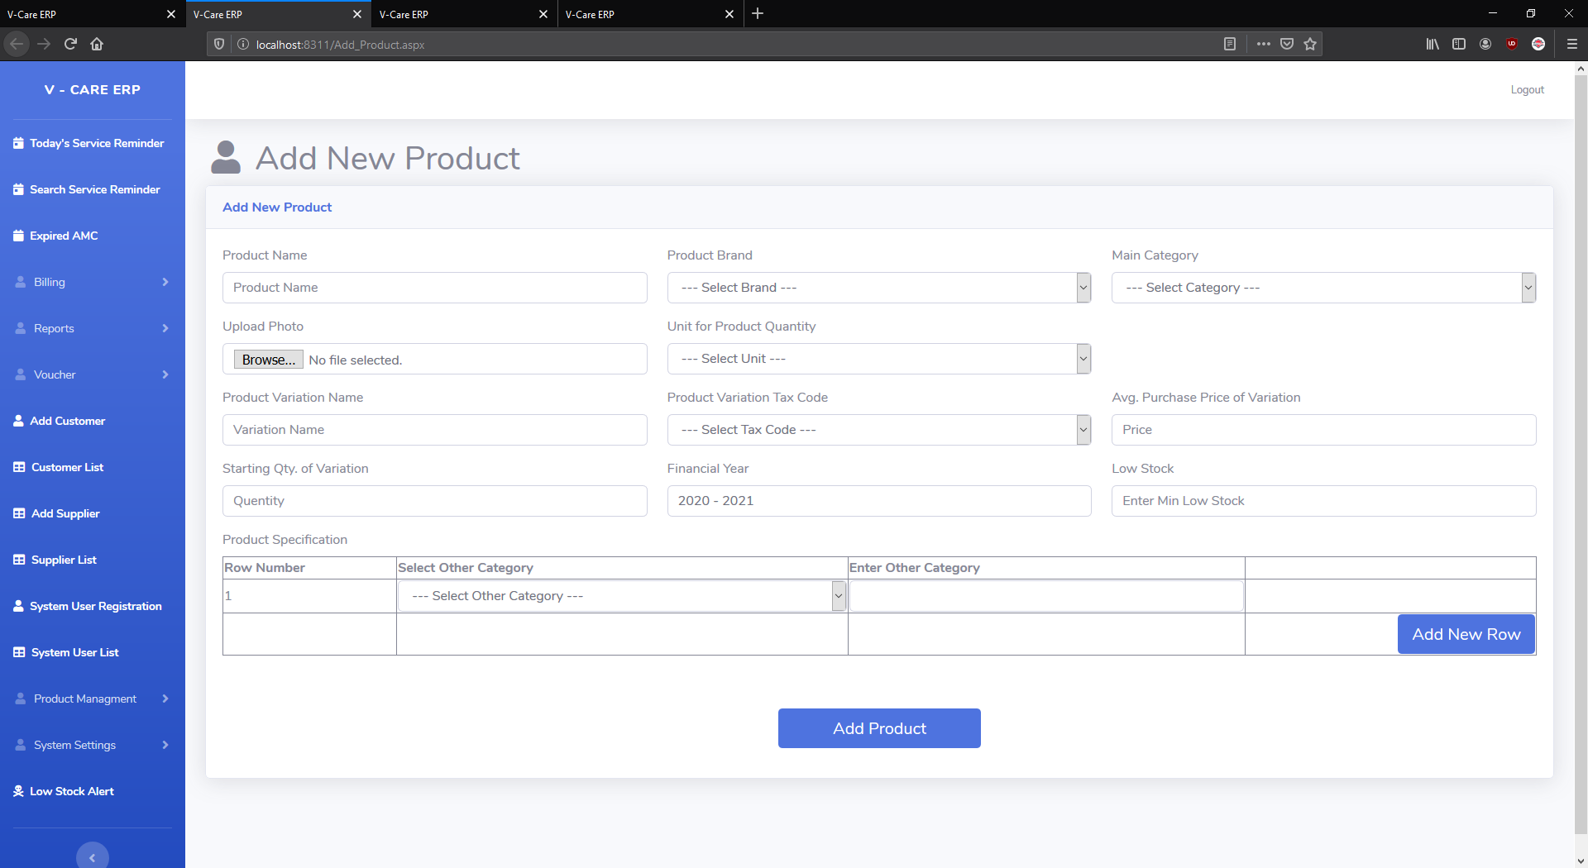
Add product.

Slide 17
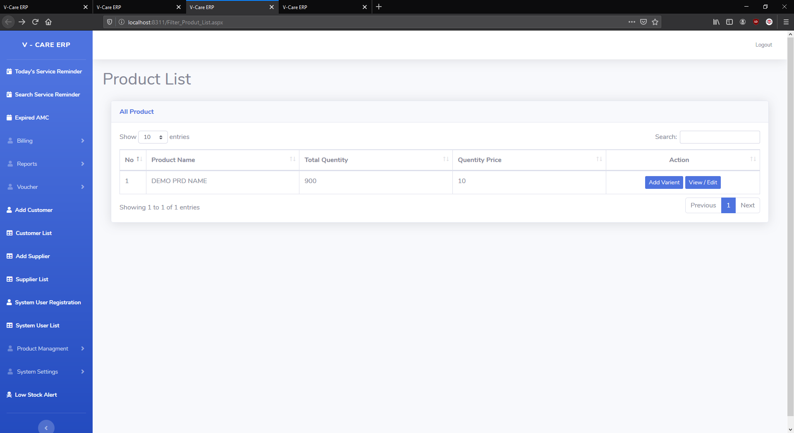
Filter product page.
One product might have more then one variation name in this page you can see list of the product by product variation name.

Slide 18
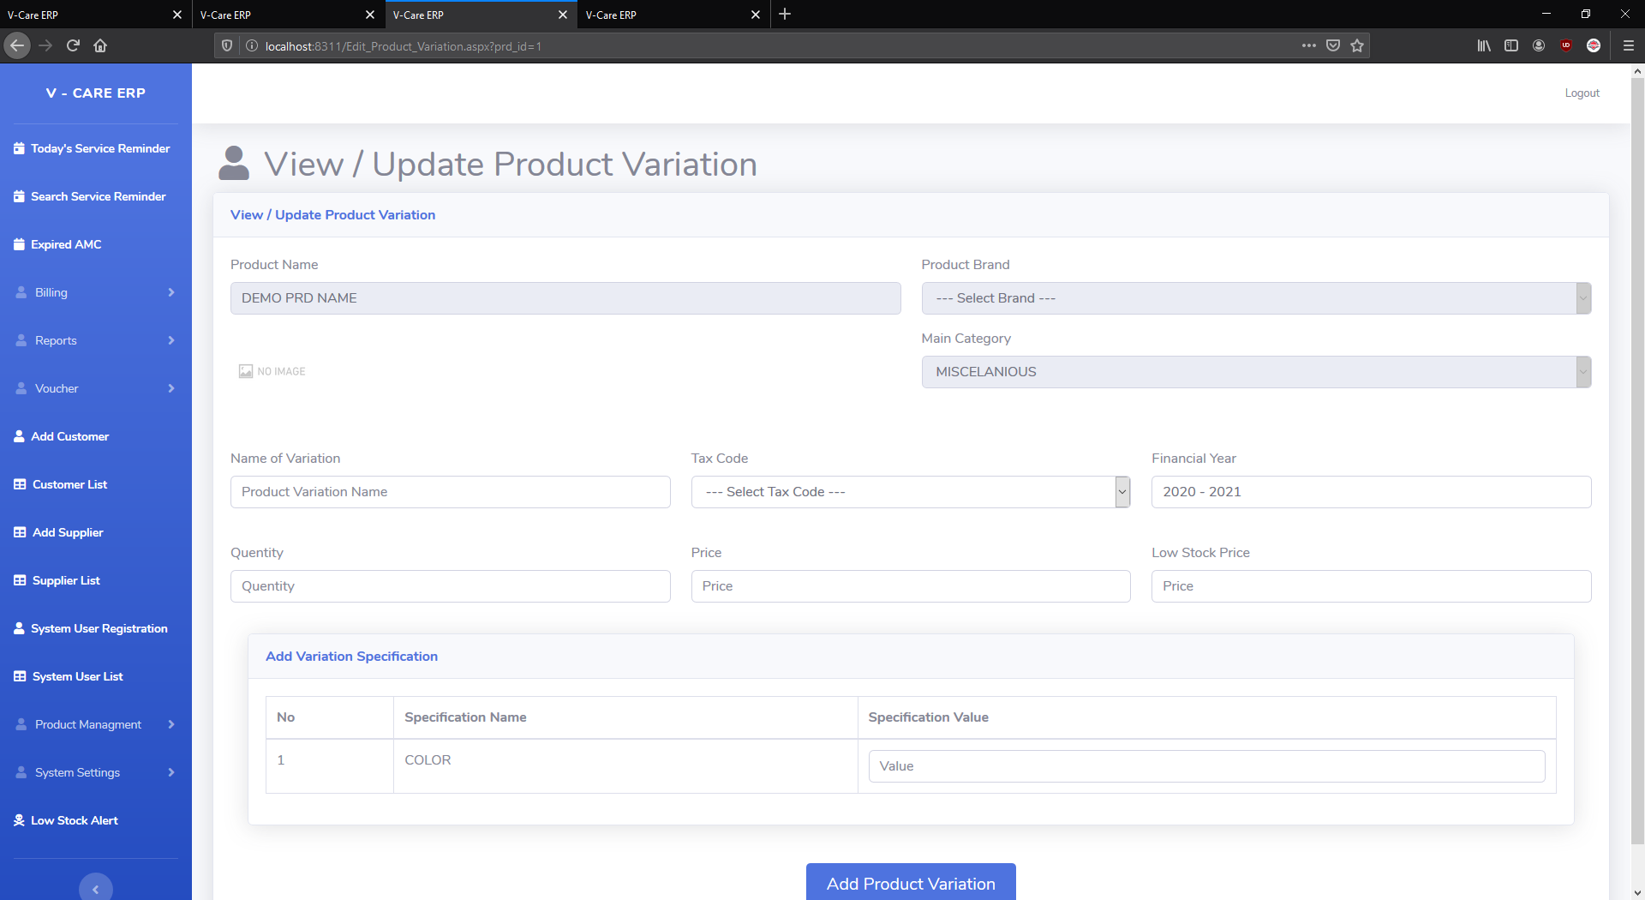
Add Product variation.
Ex.mouse has wired mouse,hp wireless mouse, dell wireless mouse and so on.
If you alredy add one mouse then you don’t have to add wireless mouse as new product it is just variation of mouse.

Slide 19
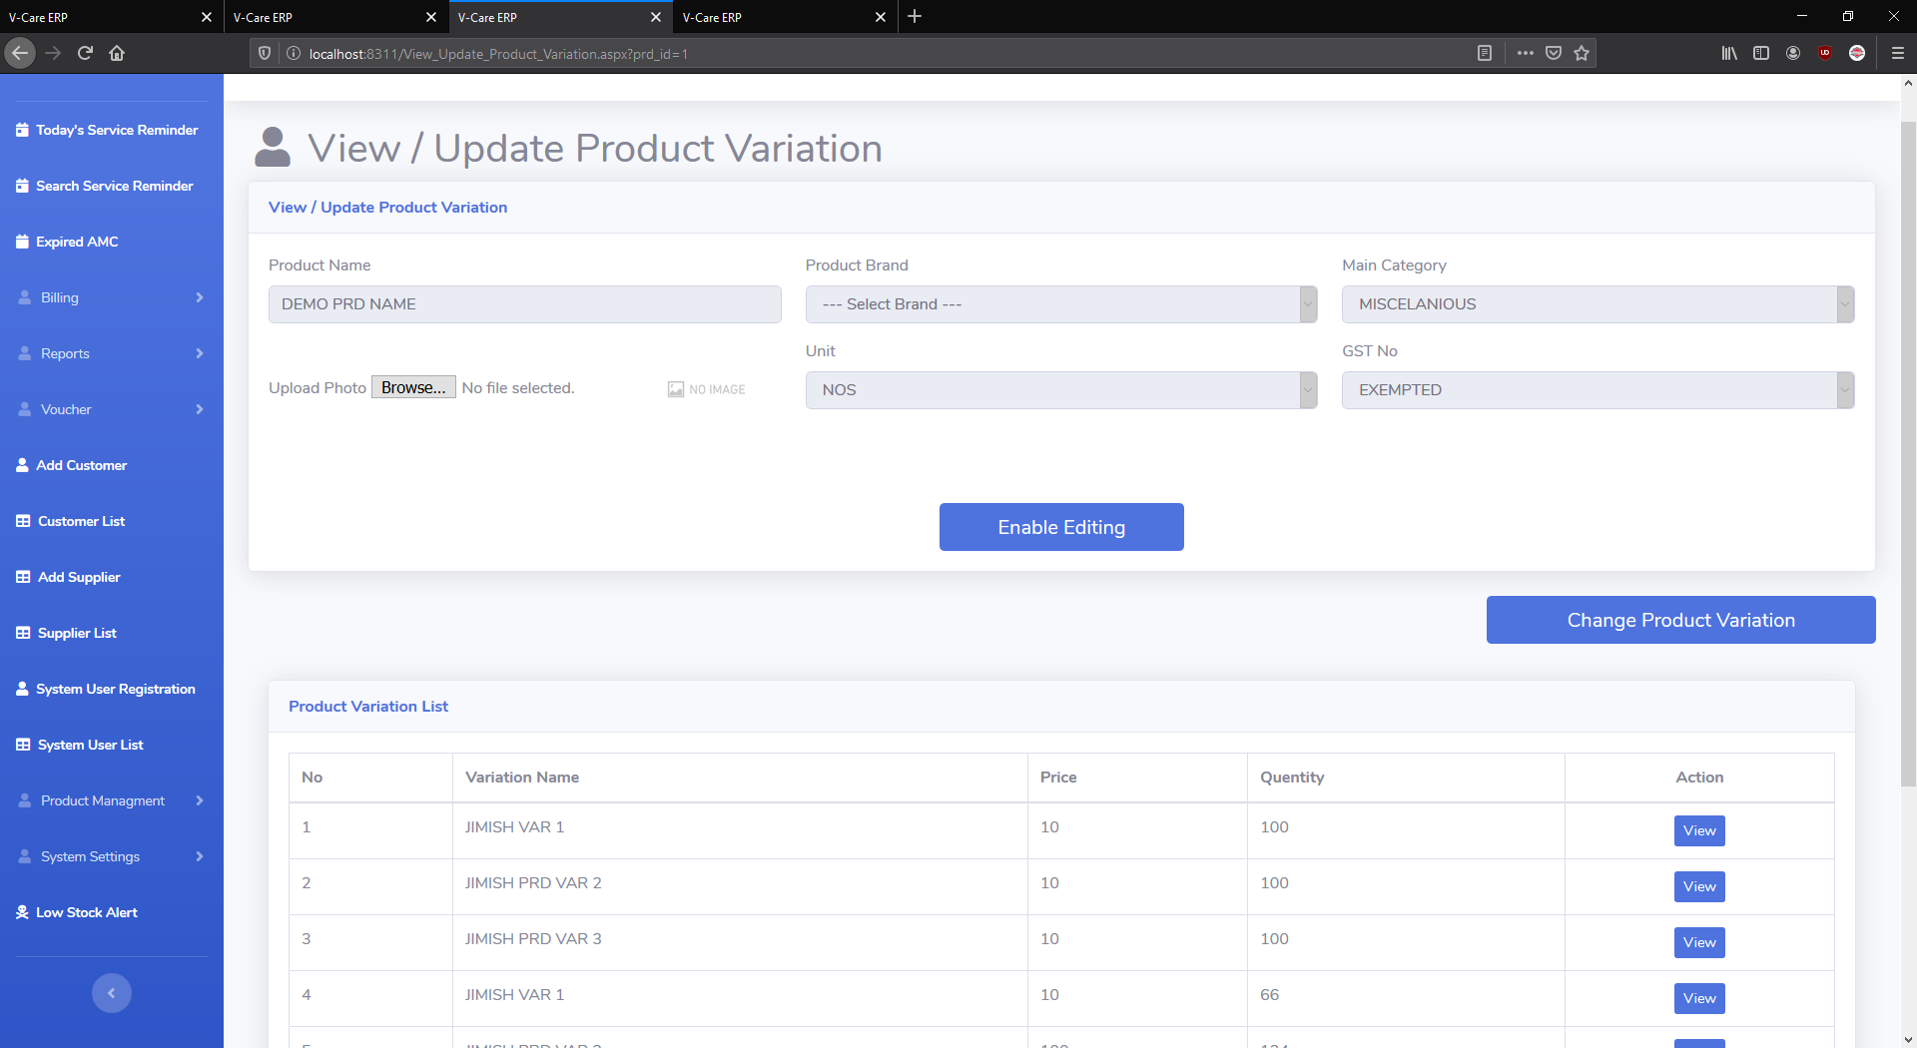
Update product variation.

Slide 20
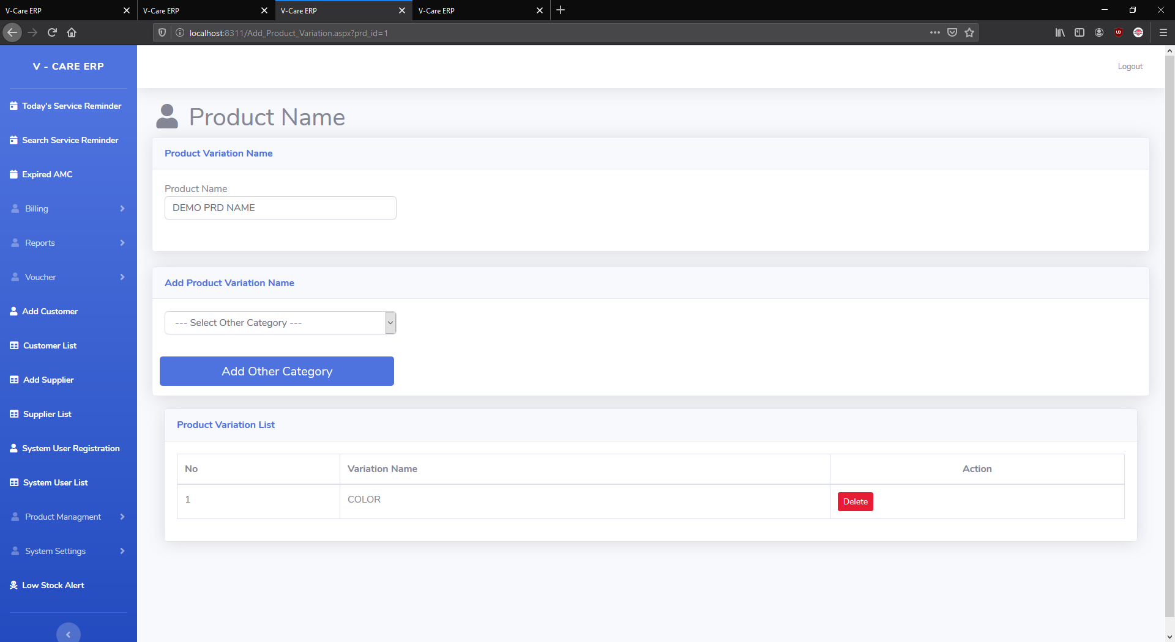
Add / update product variation.

Slide 21
If you forgot to add any variation of product then later you can add product variation in that product.
But there is a thing if you add ex.color variation in mouse then all the product variation you created that color variation
Will be added to all the variation.
You can change the value of that variation later.

Slide 22
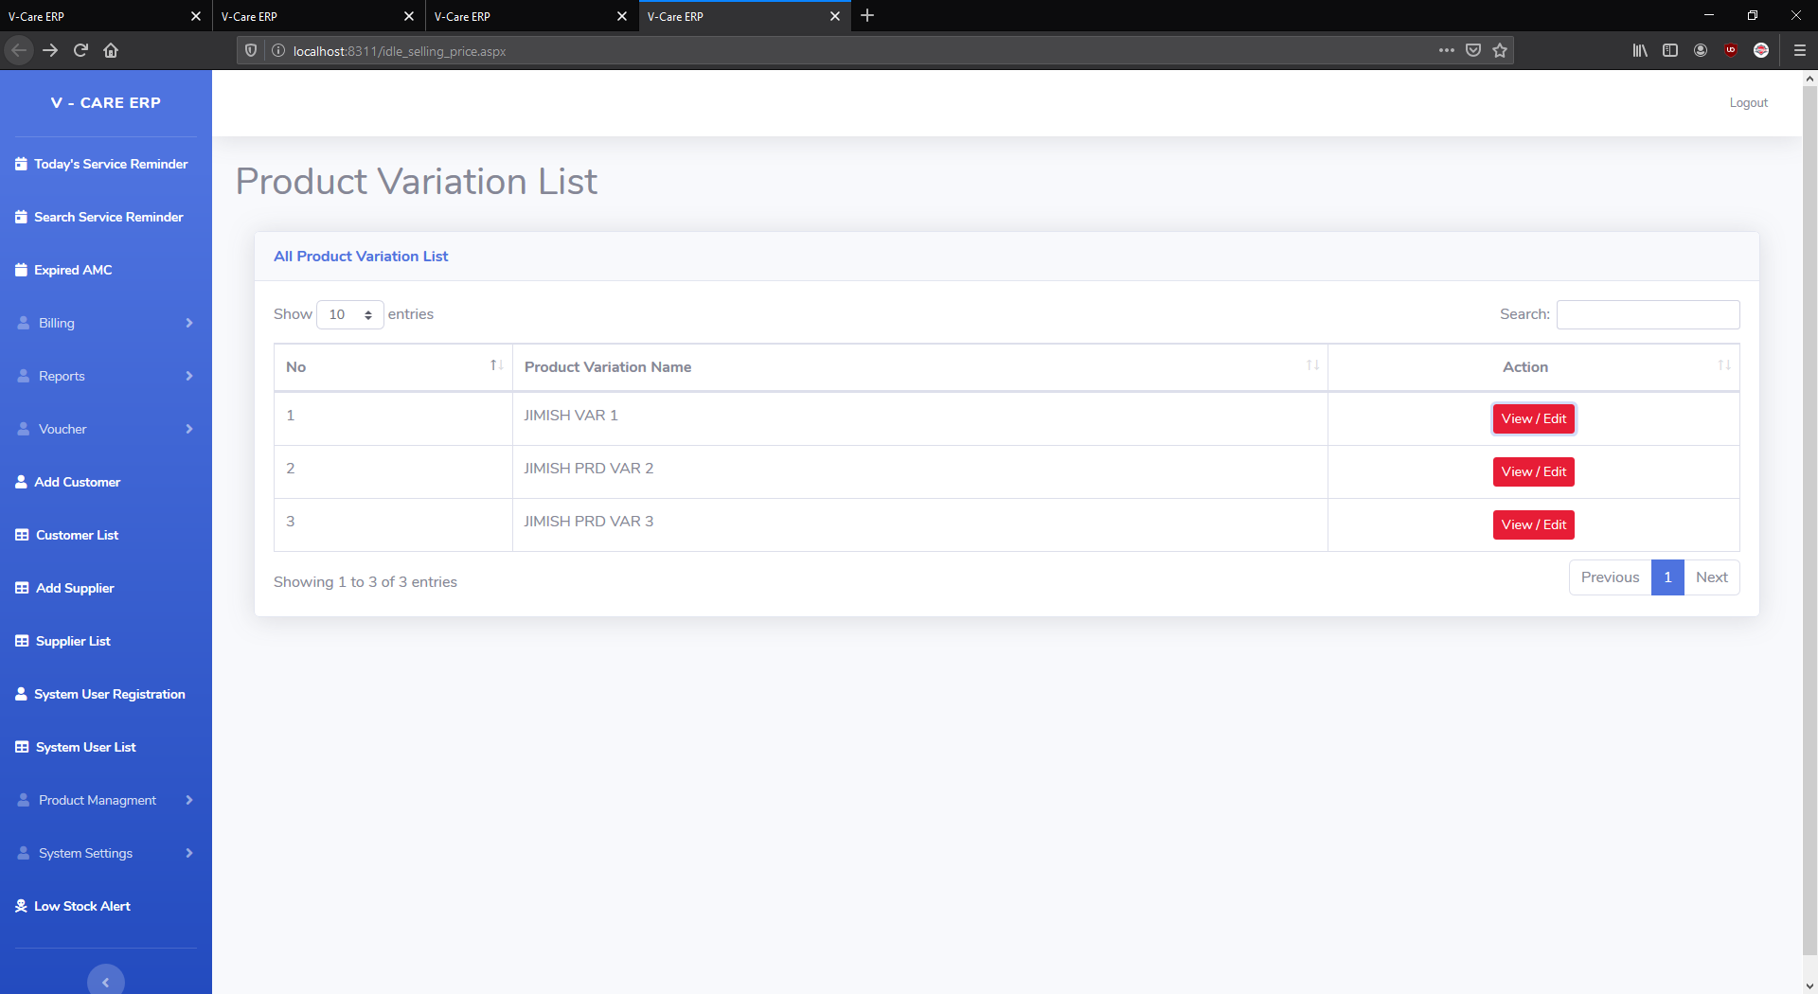
Idle selling price.
Idle selling price will help you when you create your bill idle selling price will automatically filled in textbox.

Slide 23
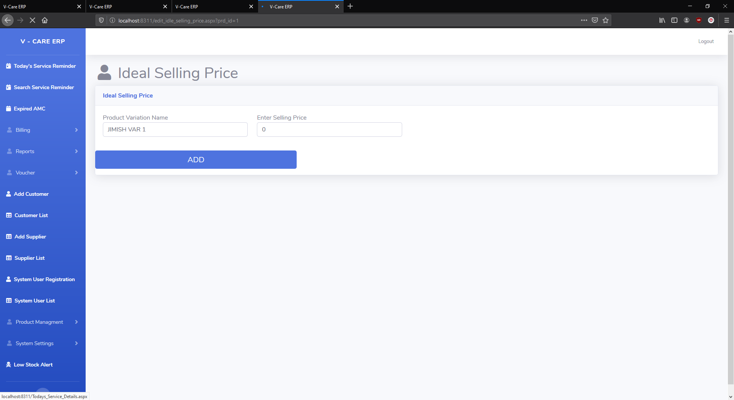
Edit idle selling price.

Slide 24
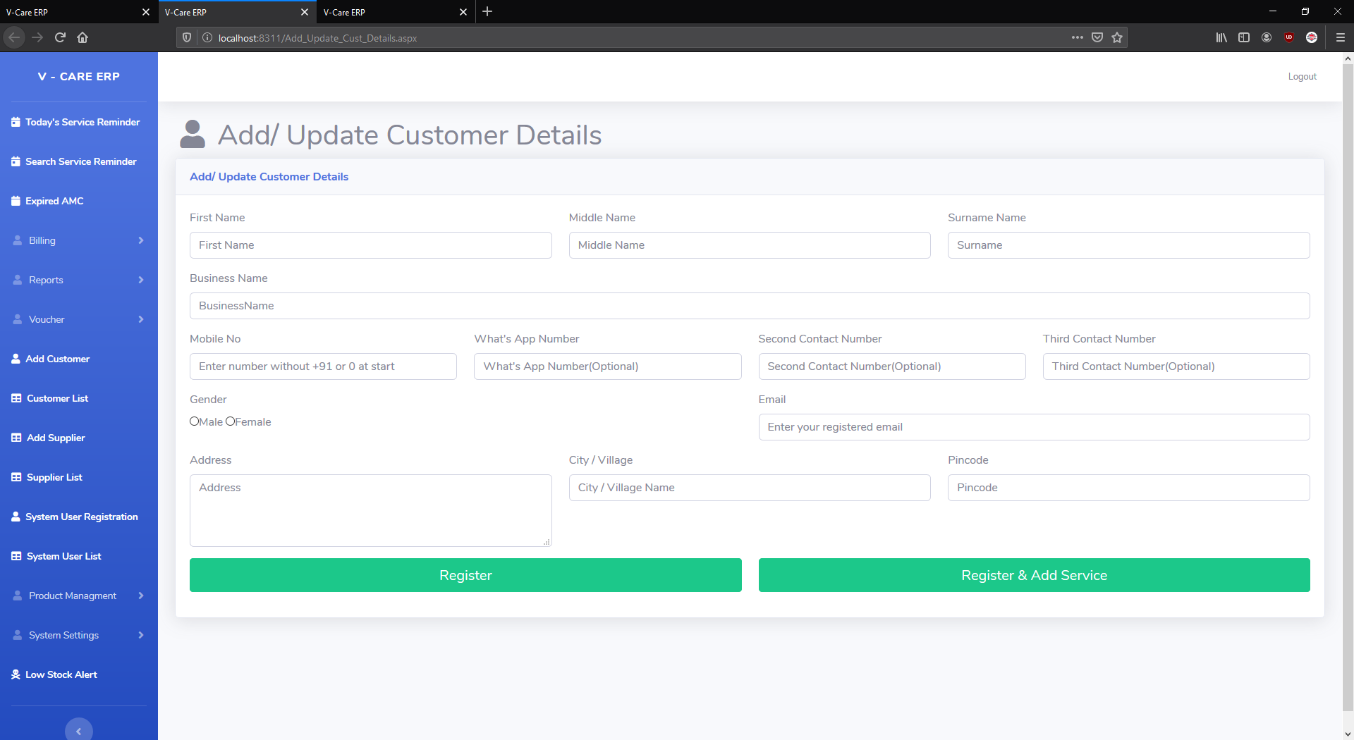
Add customer.
You can add your all customers from here.

Slide 25
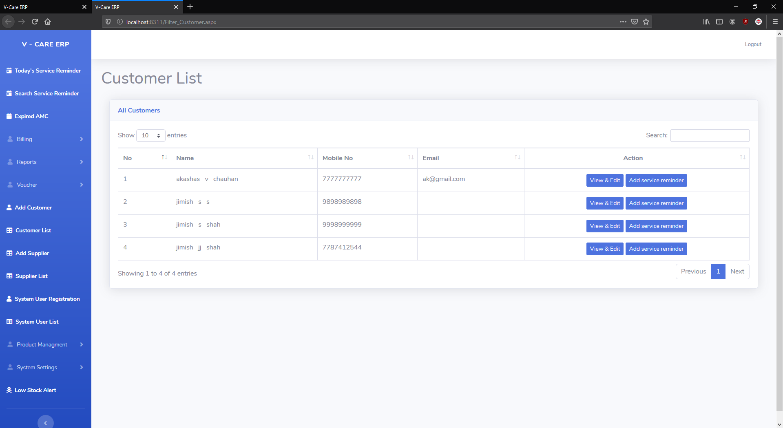
All customer list.

Slide 26
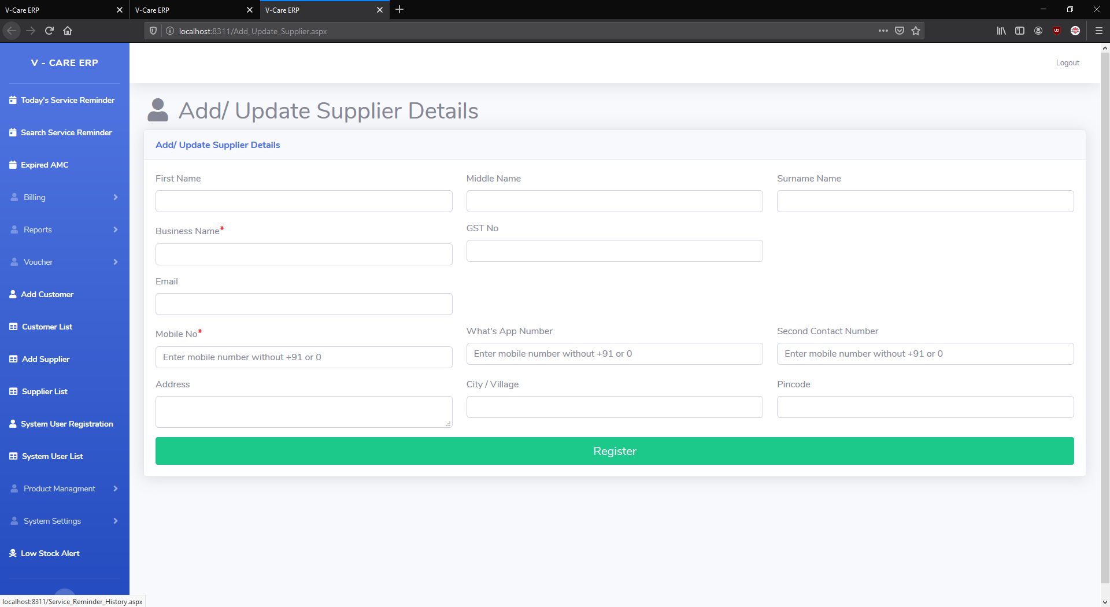
Add/update supplier.

Slide 27
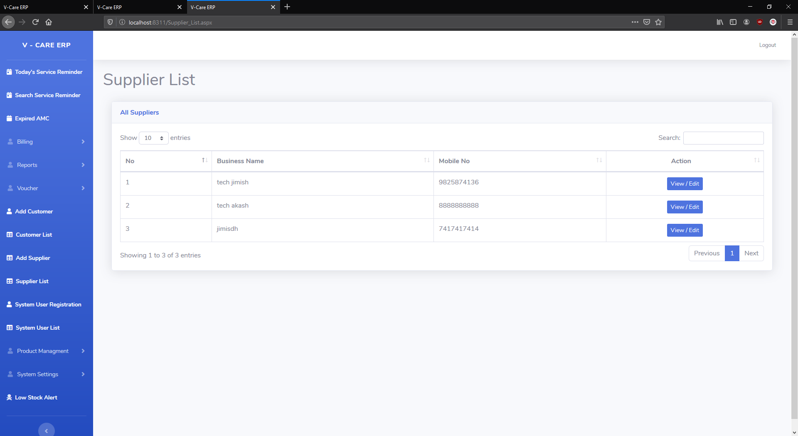
Add supplier list.

Slide 28
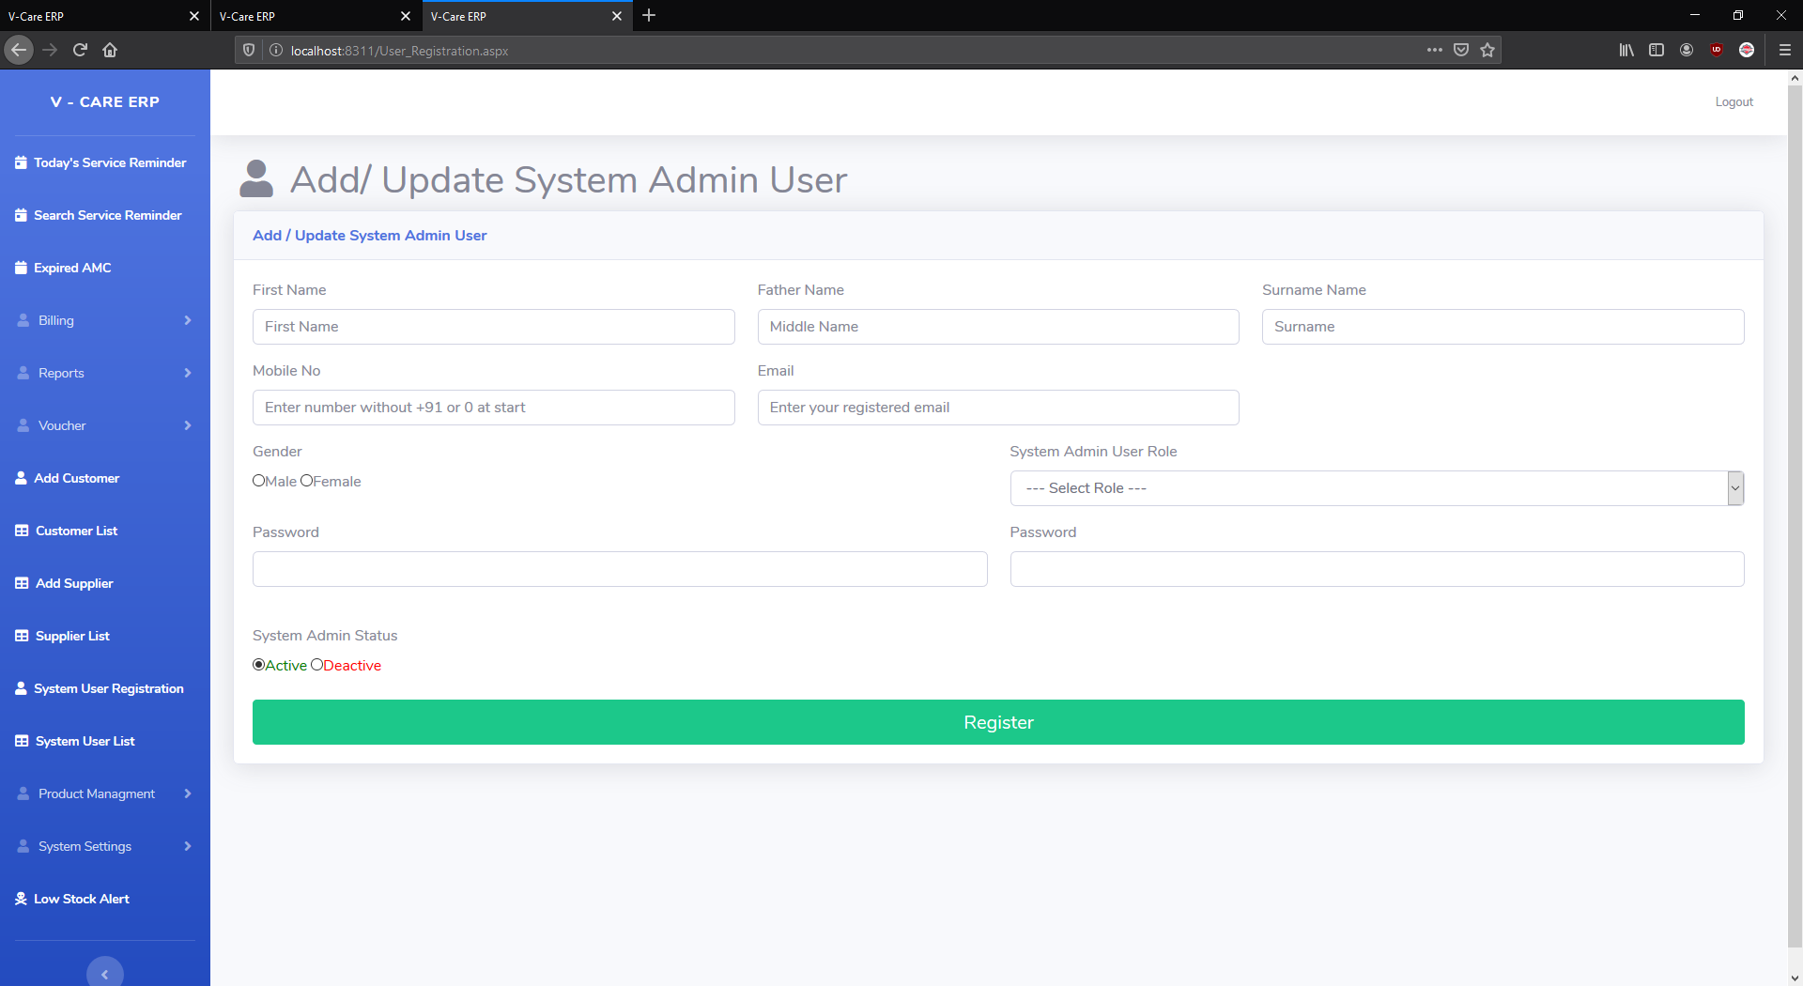
Add/update system admin.

Slide 29
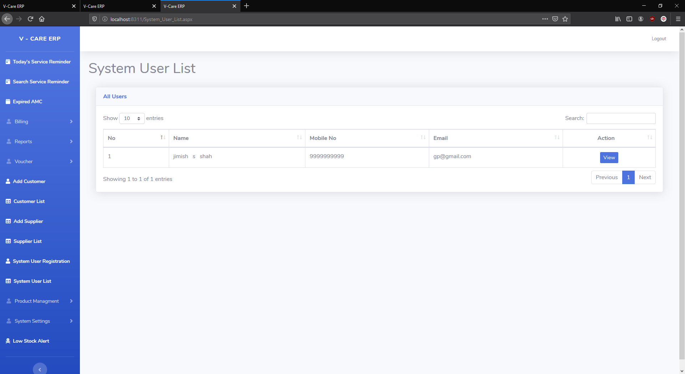
System user list.

Slide 30
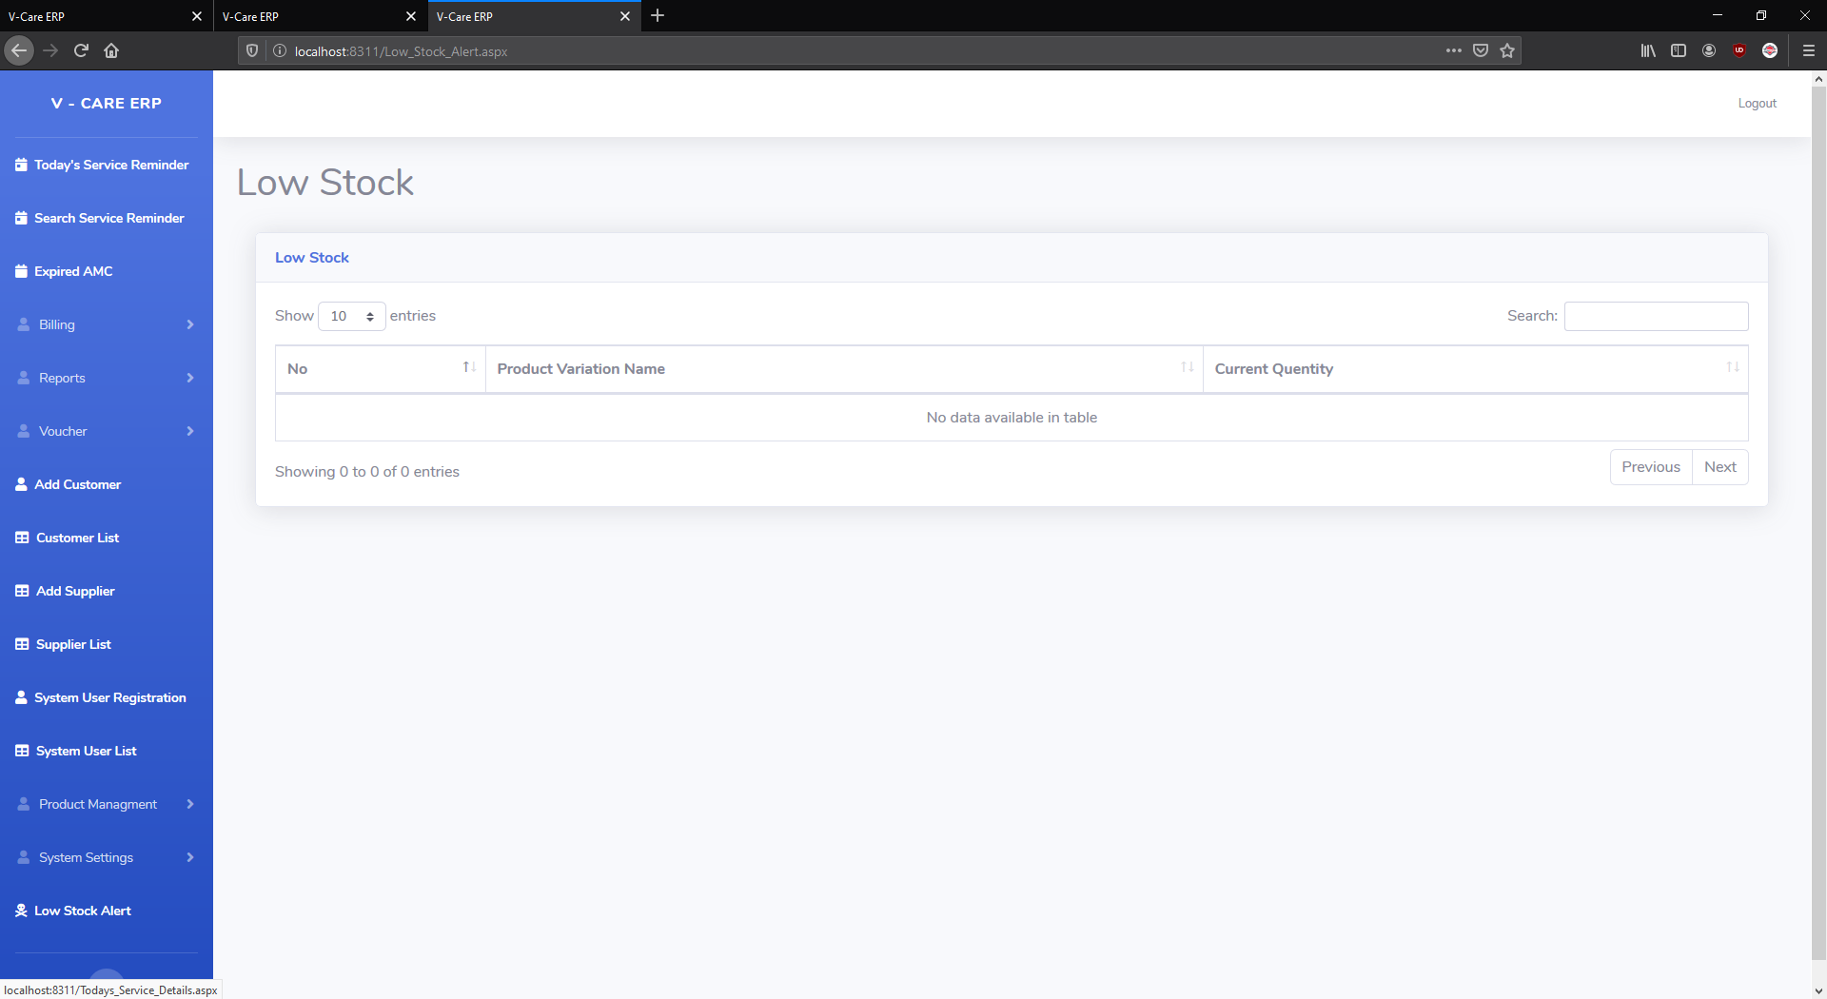
Low stock alert.
You can add low stock when you enter your product if you stock get low then you can that low stock here.

Slide 31
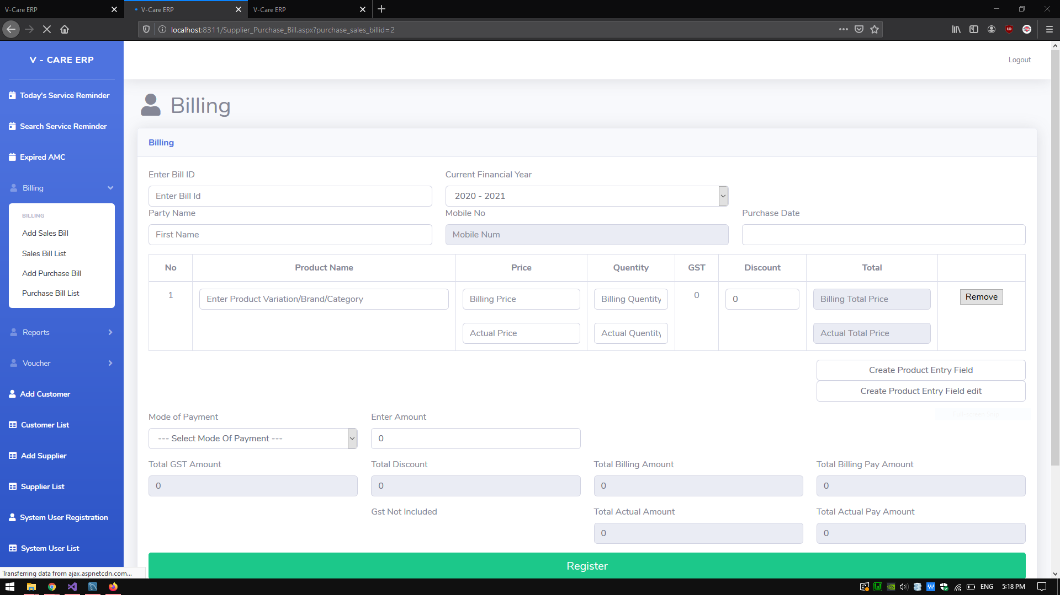
Sales bill page.

Slide 32
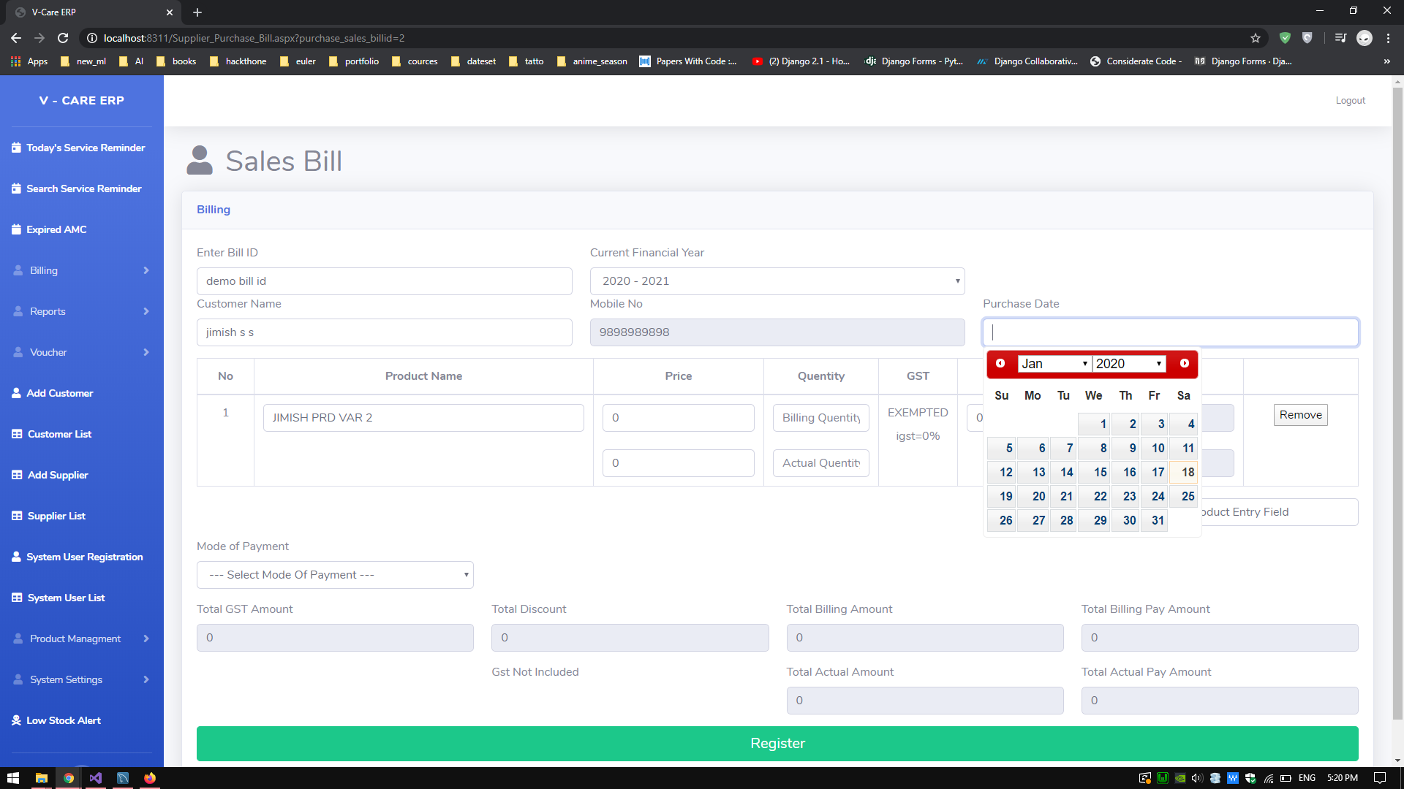

Slide 33
In sales bill page when you type customer name it will see autocomplete then you have to select one of then customer then
You select if will automatically select customer phone number .
Then and only then you can create your bill.
If your customer don’t have in customer list then you first have to insert that customer and after that you can create
That bill.

Slide 34
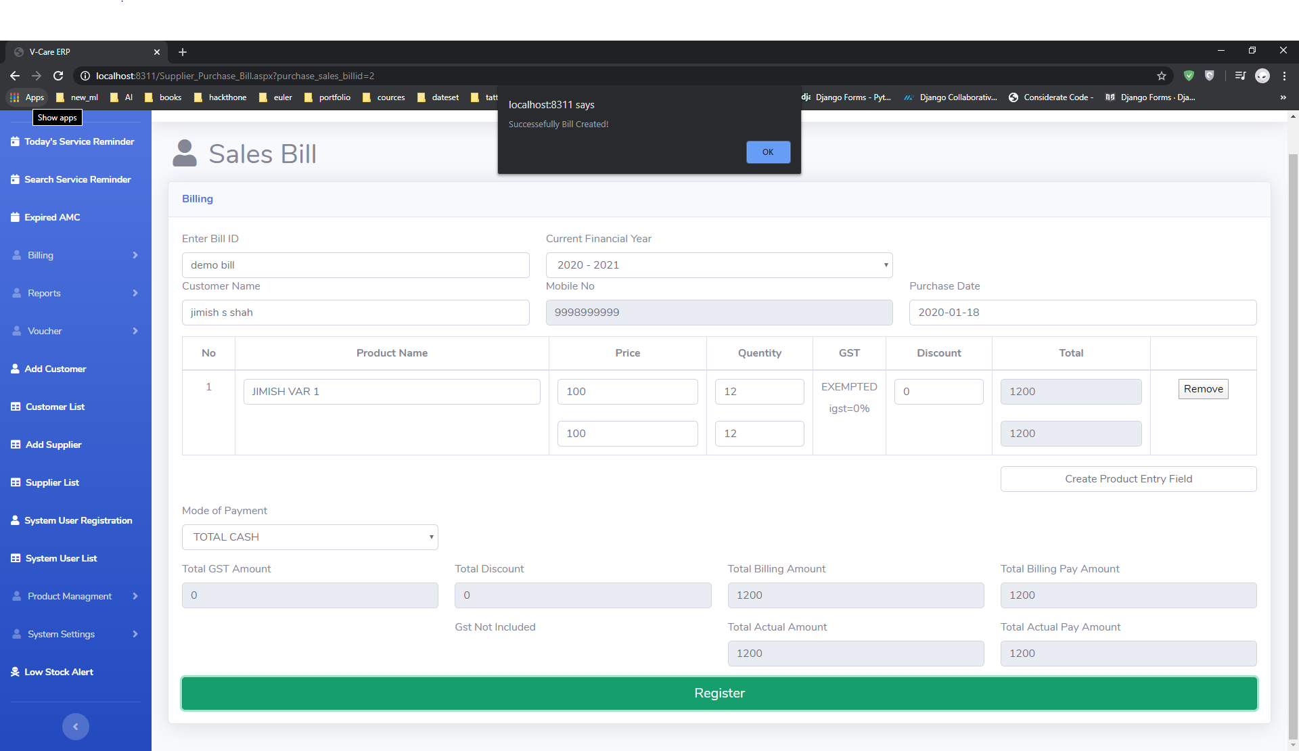

Slide 35
That same autocomplete applied for product as well.
If there is idle selling price for that particular product then product price
Will automatically filled.

Slide 36
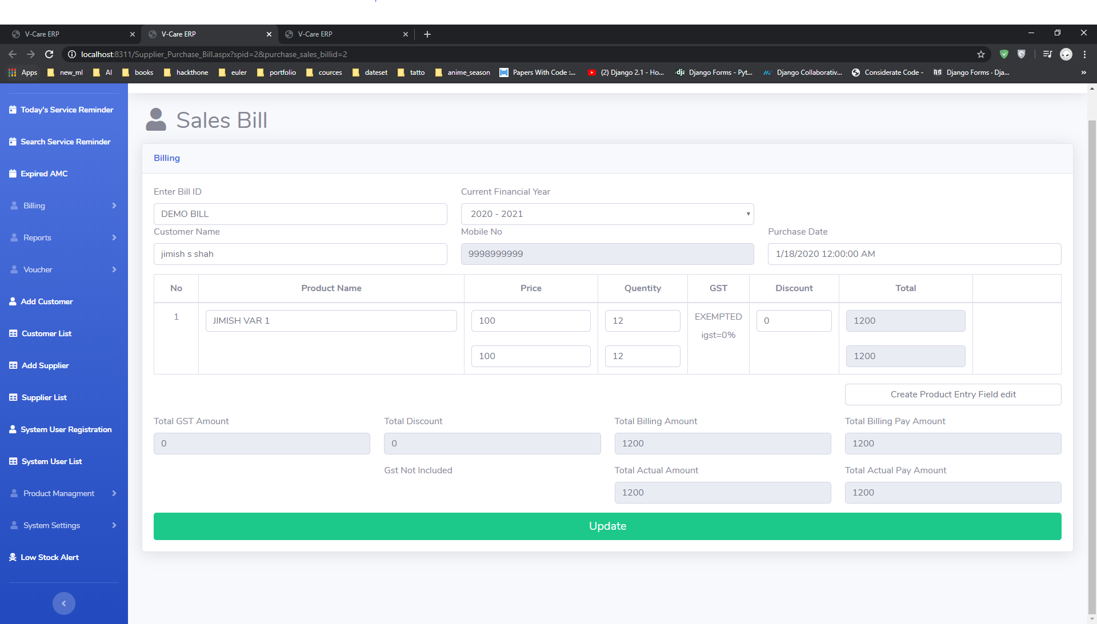

Slide 37
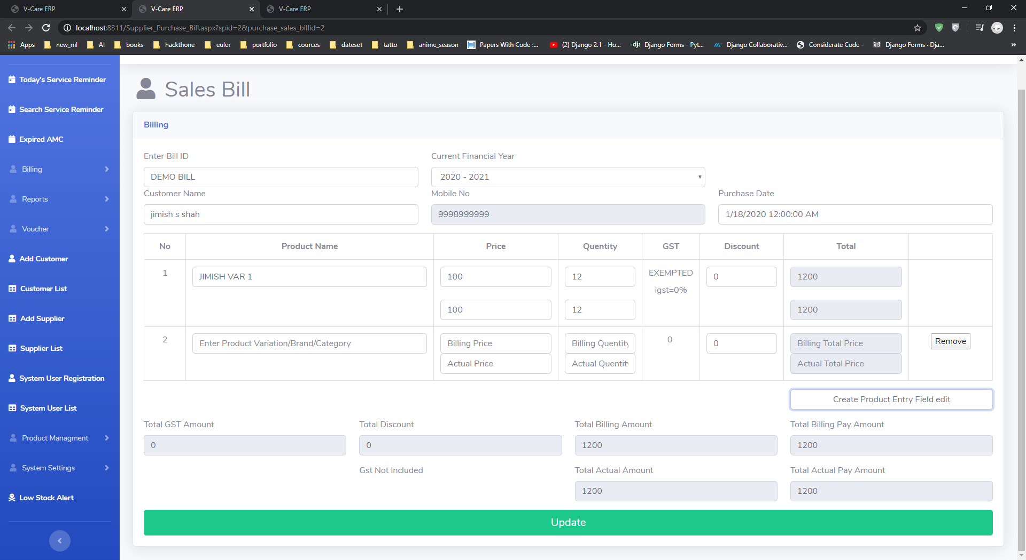
In create product entry field edit you can create all boxes.

Slide 38
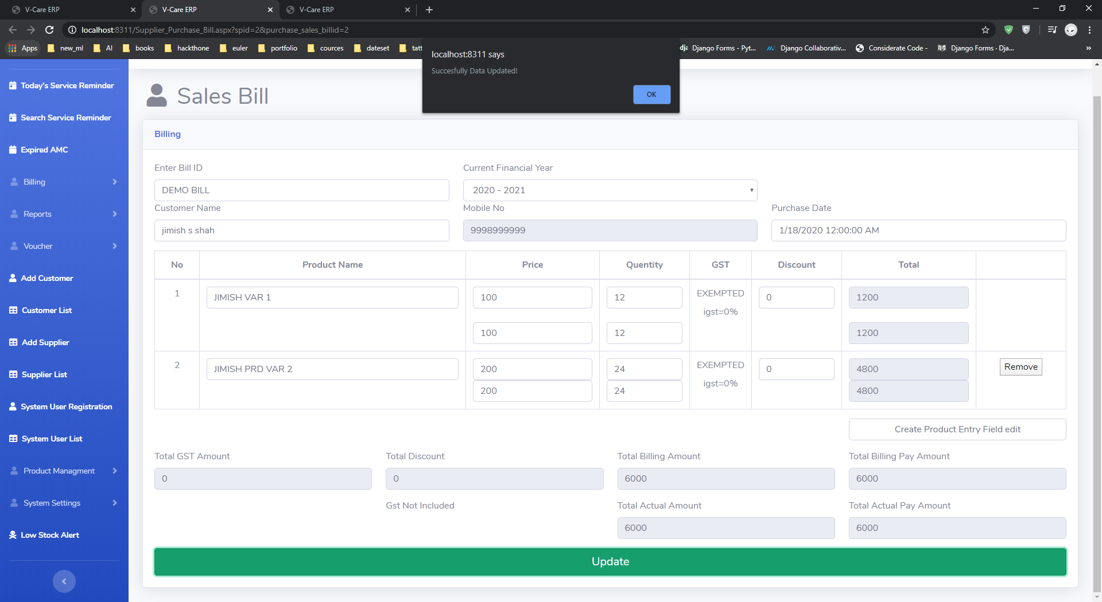
You can add/update product after creating bill.

Slide 39
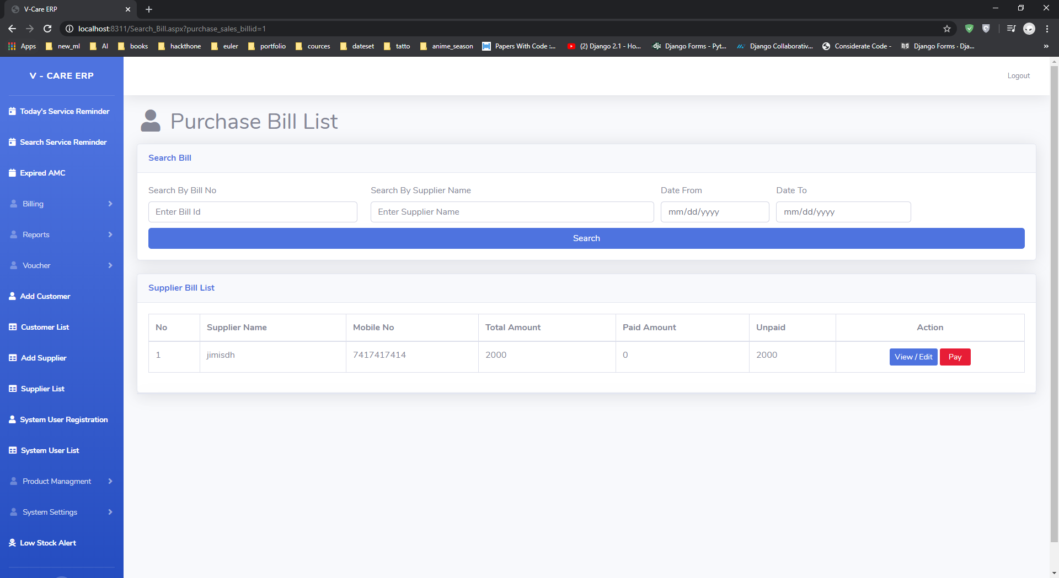
Purchase bill list.

Slide 40
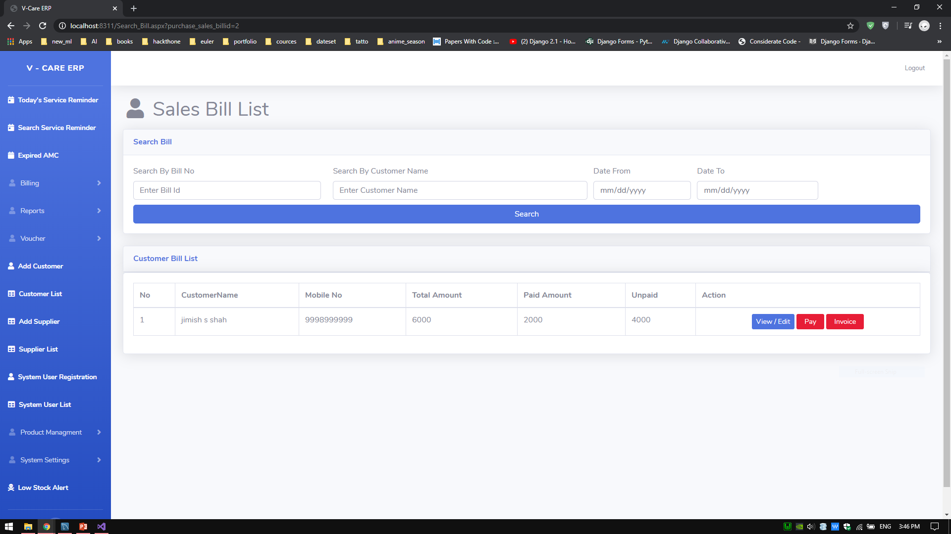
Sales bill list.
In sales bill list by clicking on invoice button you can download pdf of that bill.

Slide 41
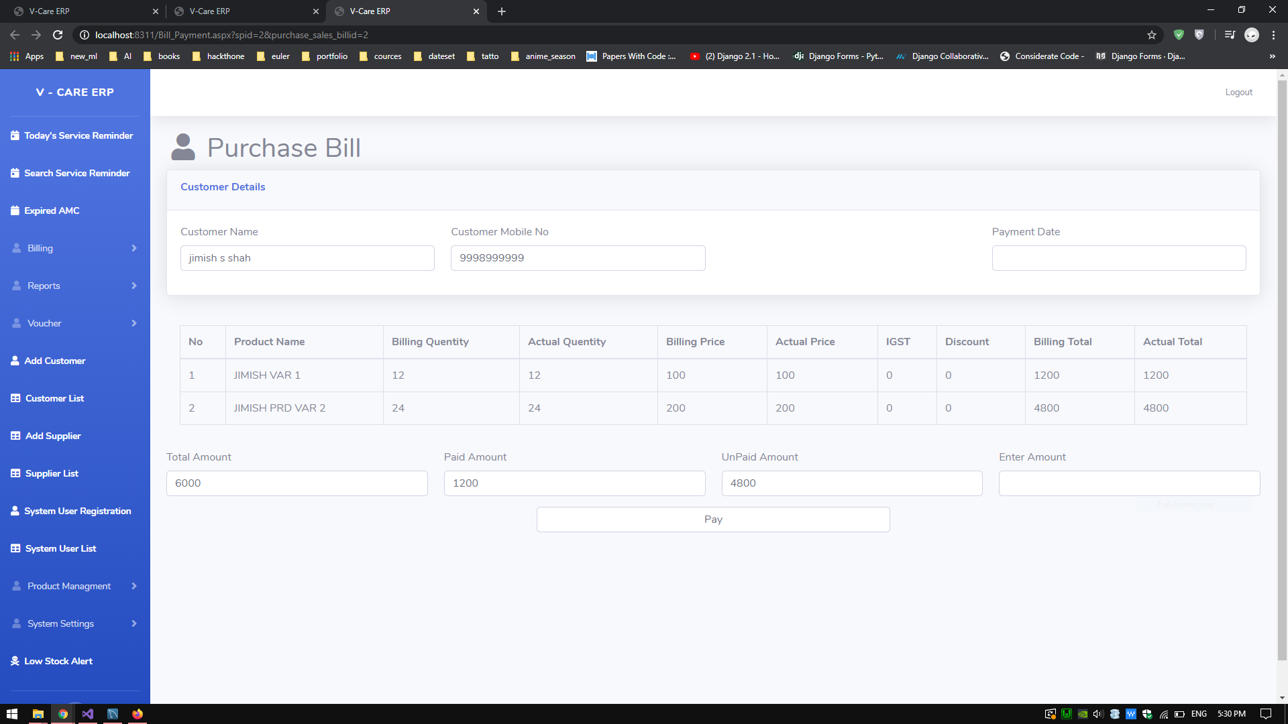
In purchase bill list you can go for bill payment.

Slide 42
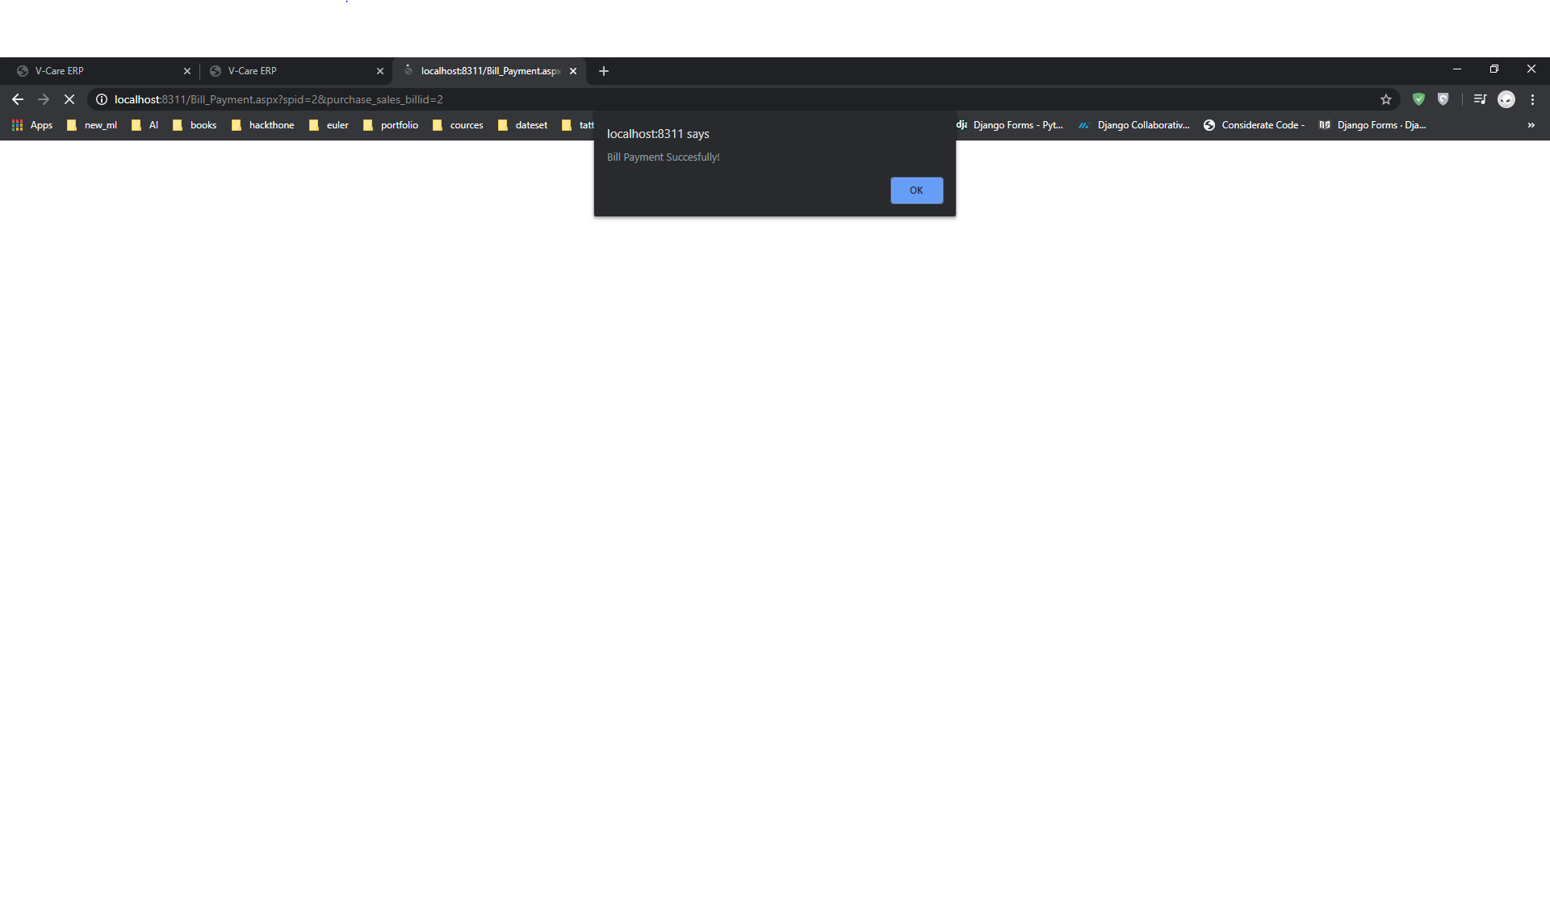

Slide 43
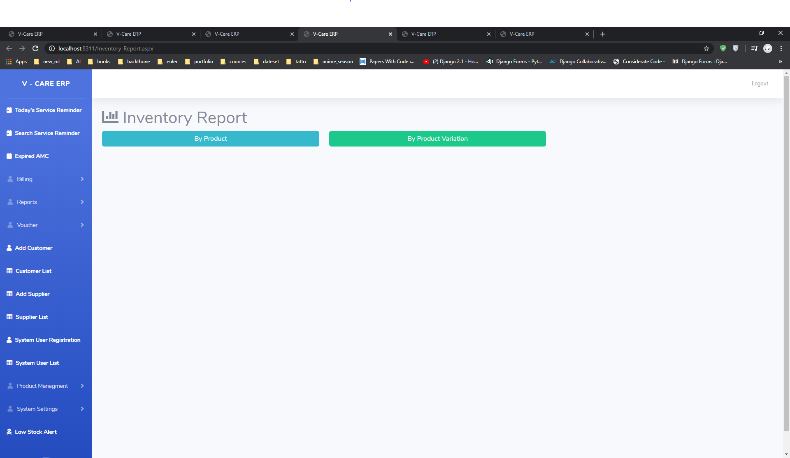
Inventory report.

Slide 44
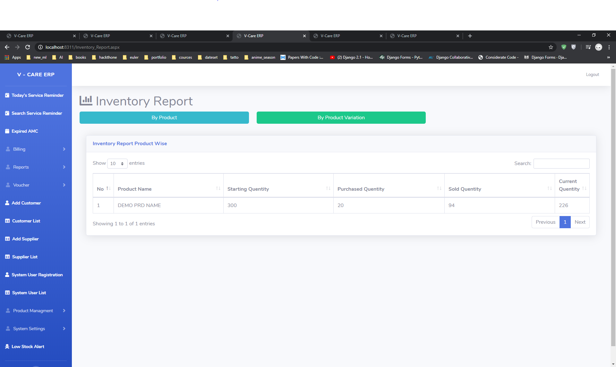
Inventory report By product.

Slide 45
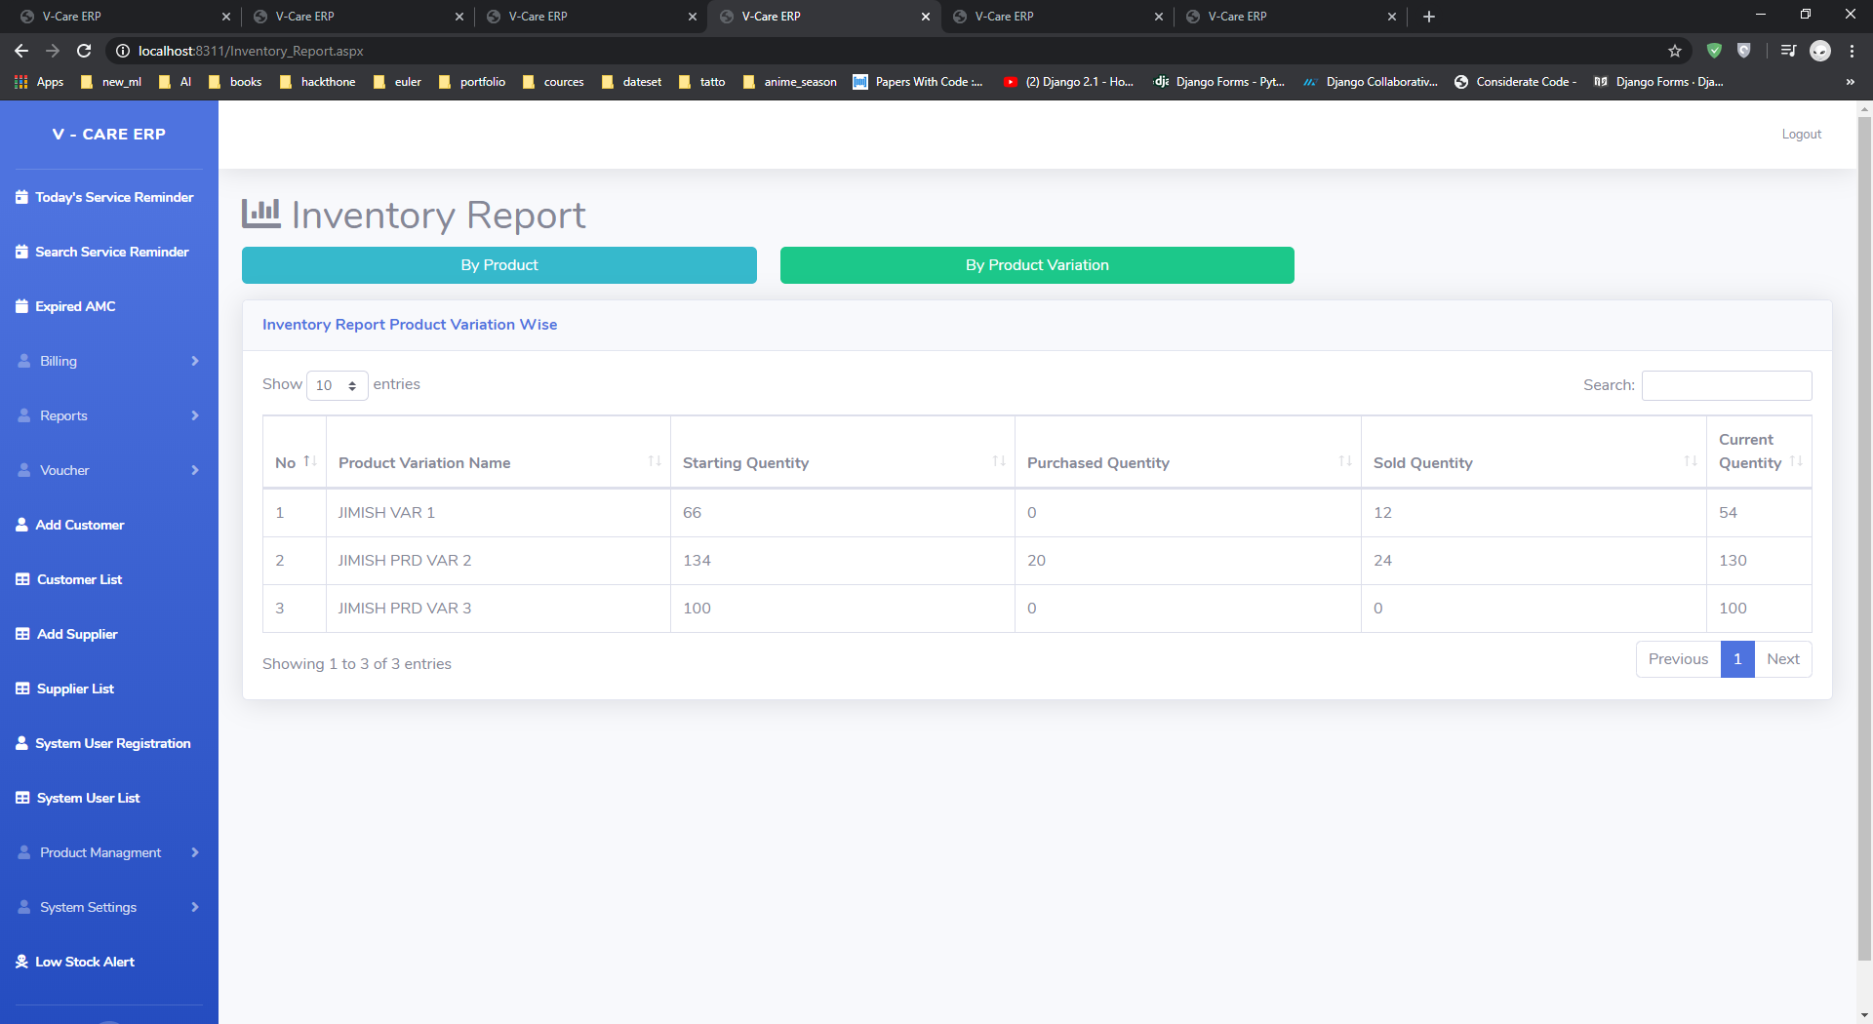
Inventory report by product variation.

Slide 46
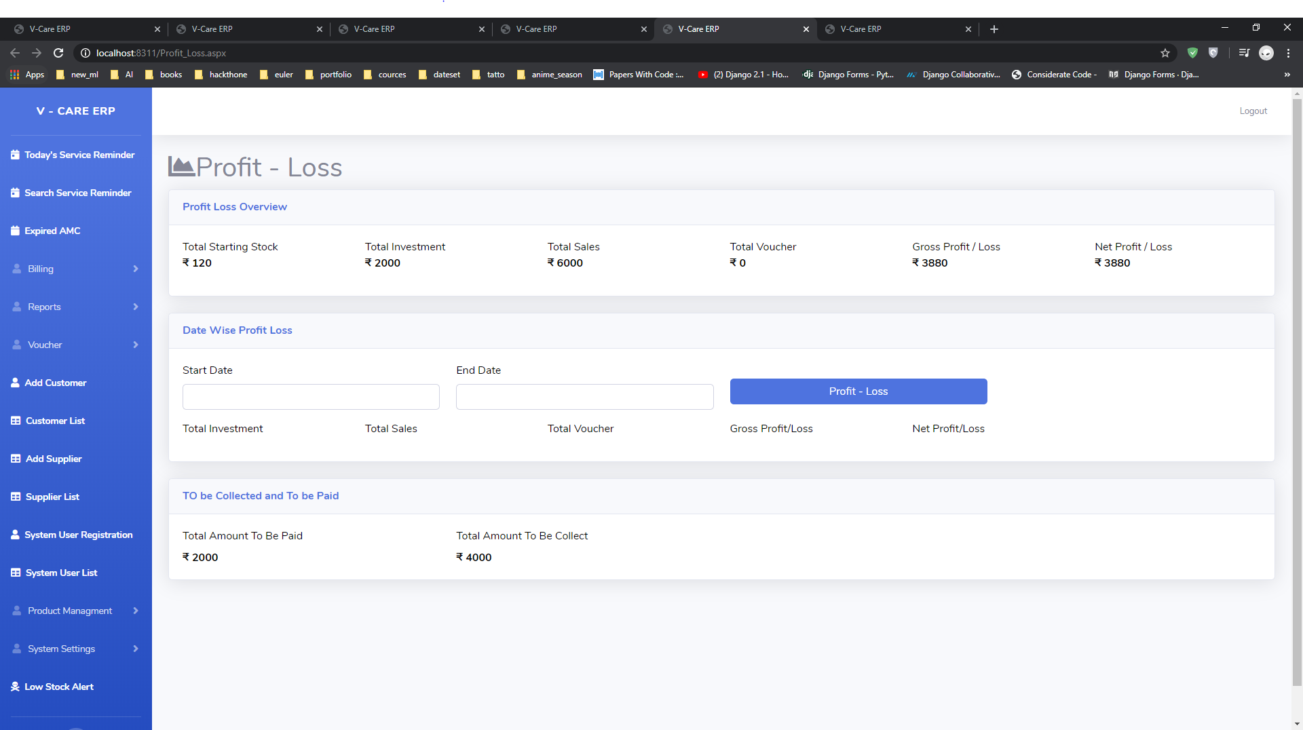
Profit-Loss report.

Slide 47
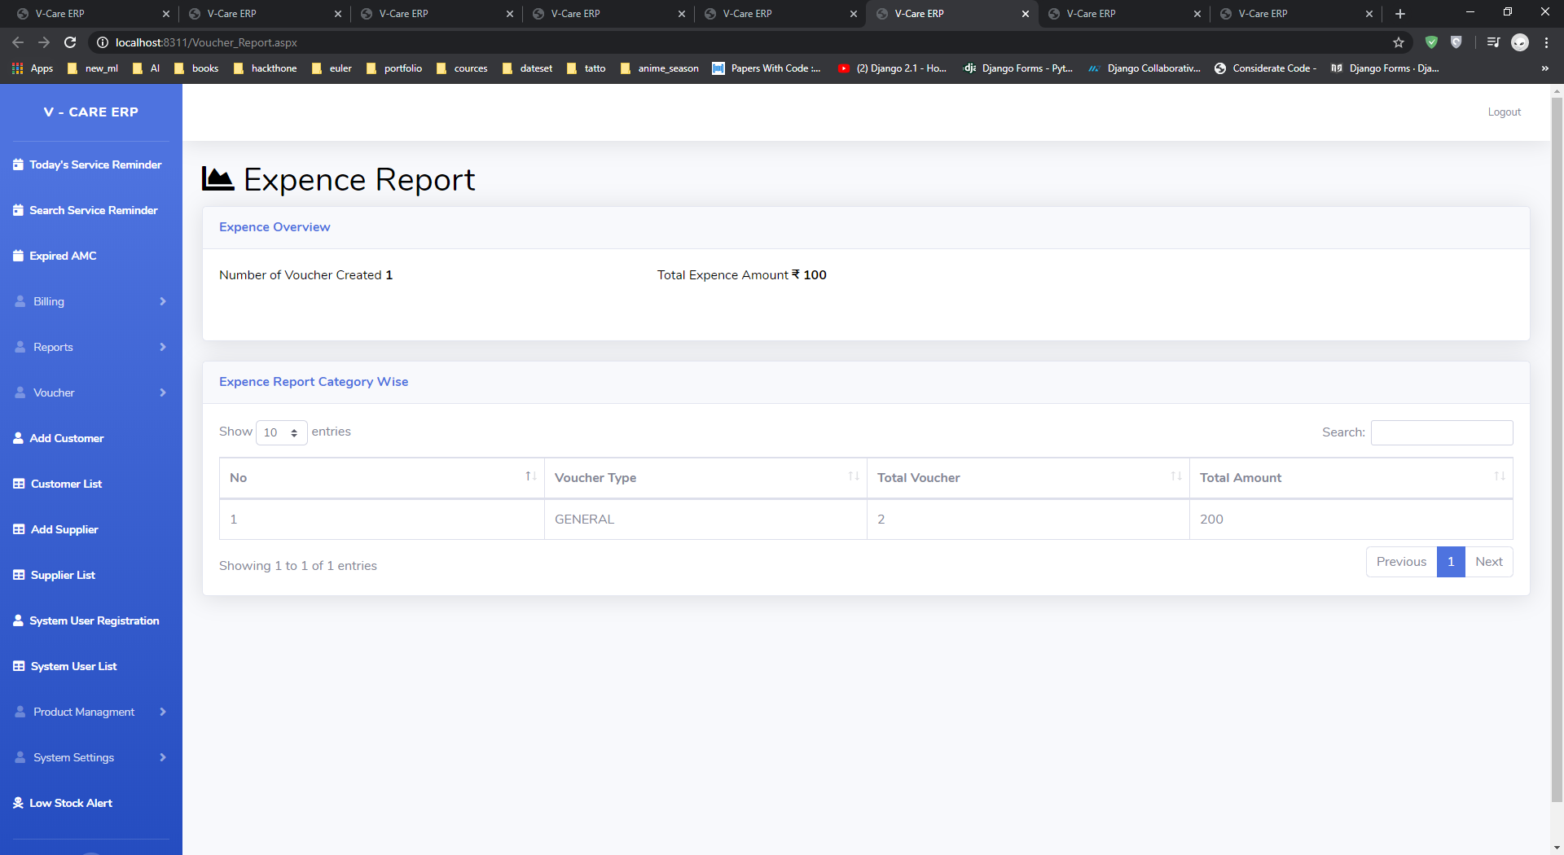
Expense report (Voucher report.)

Slide 48
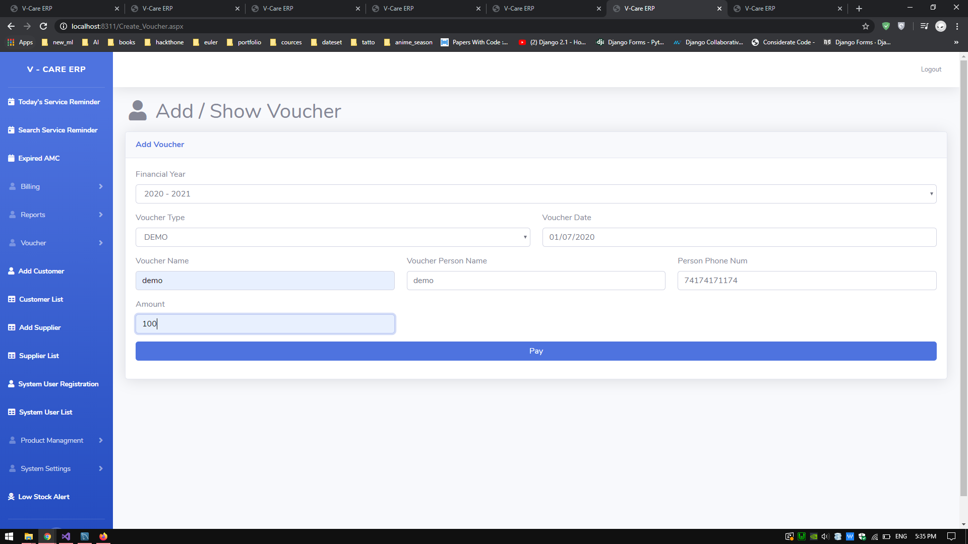
Add/Update voucher.

Slide 49
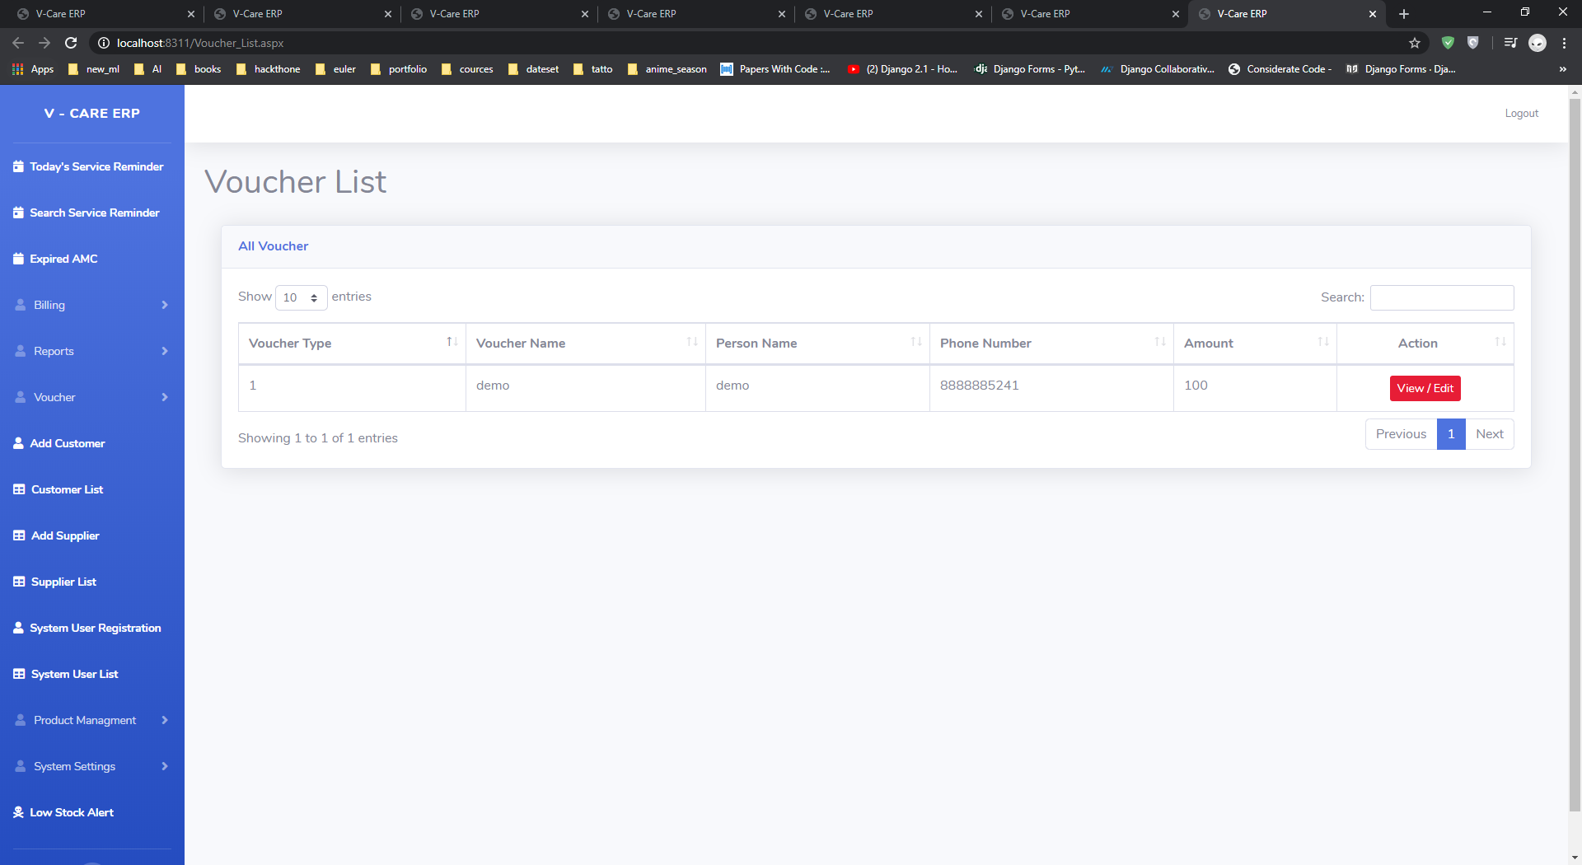
Voucher list.

Slide 50
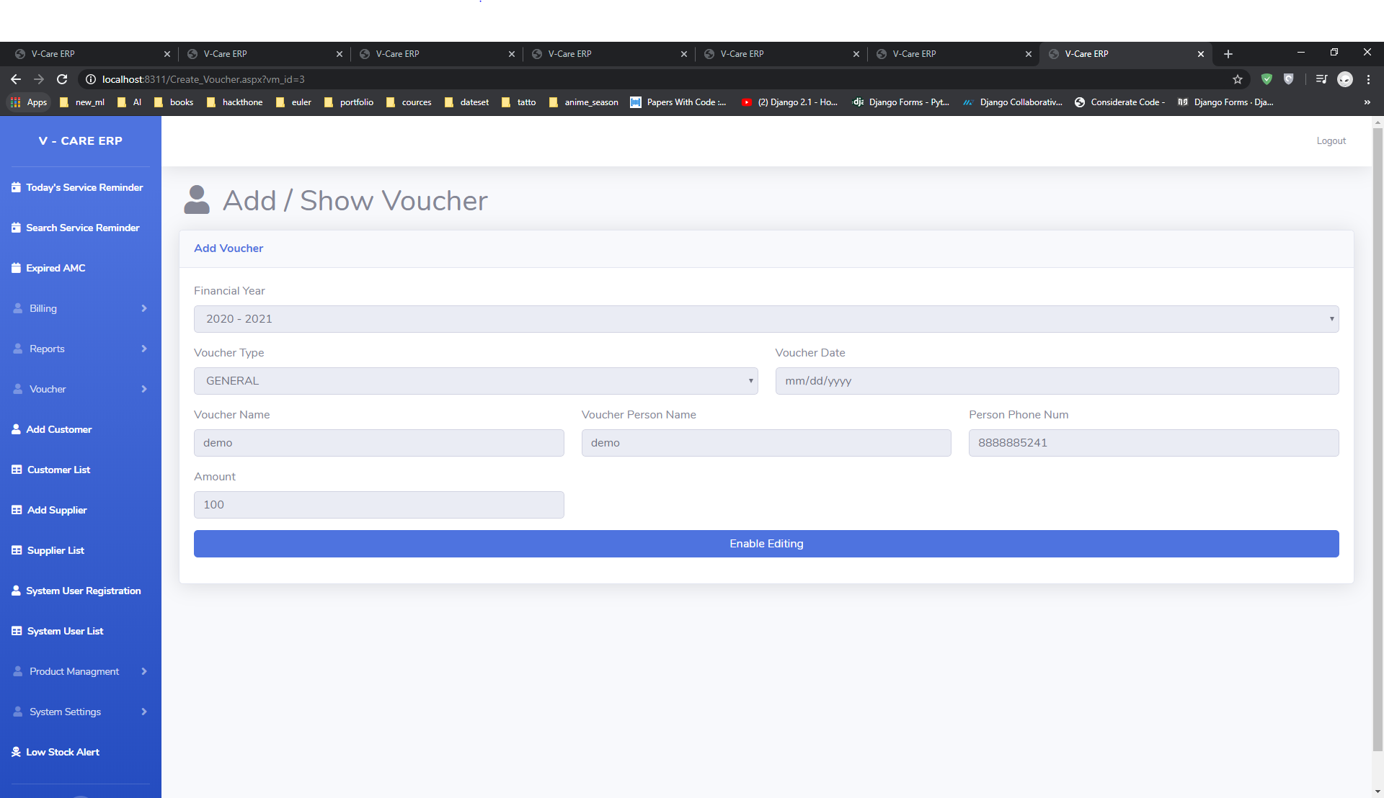
Edit voucher.

Slide 51
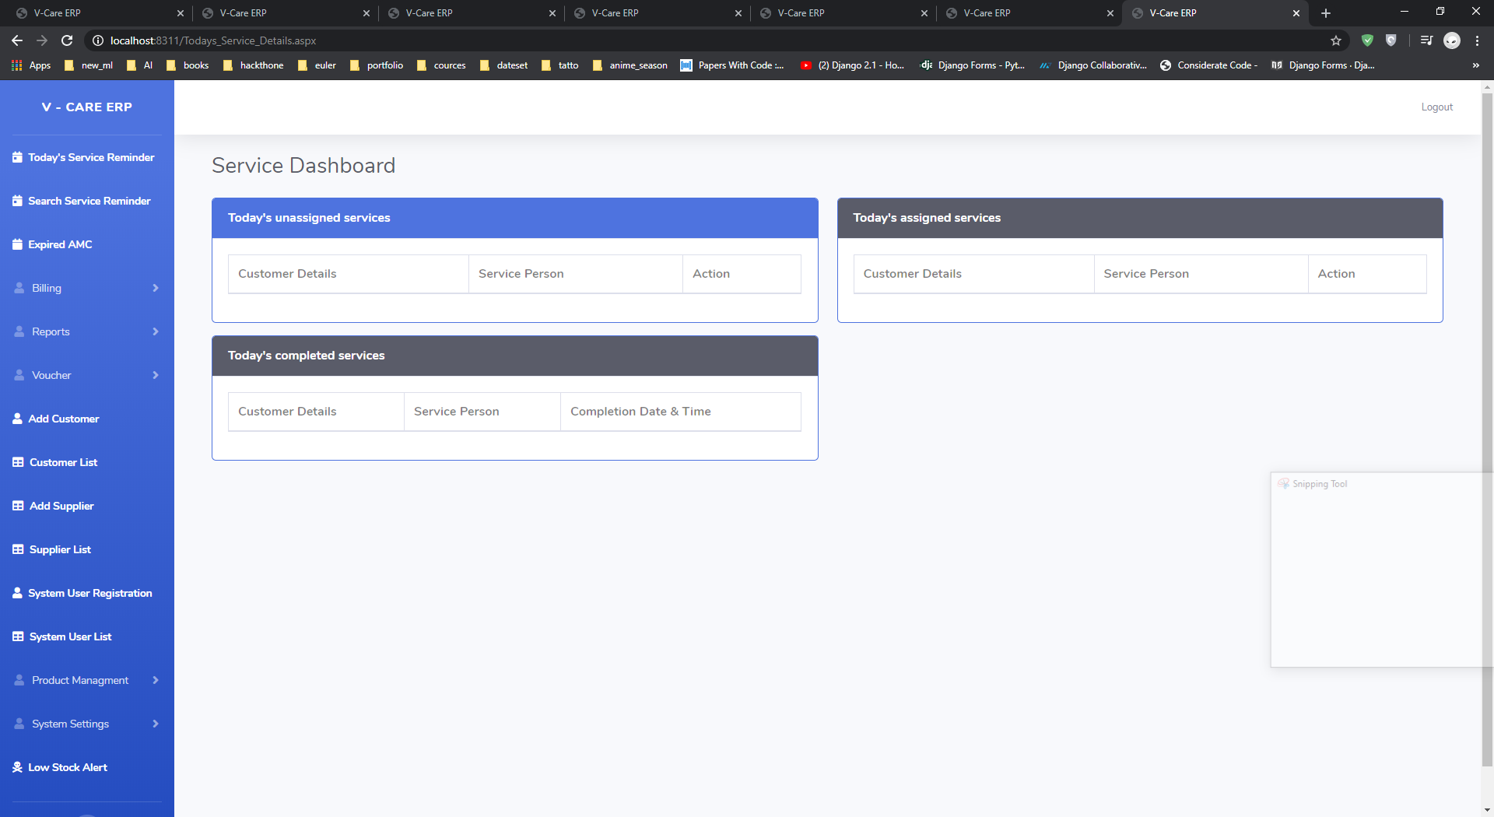

Slide 52
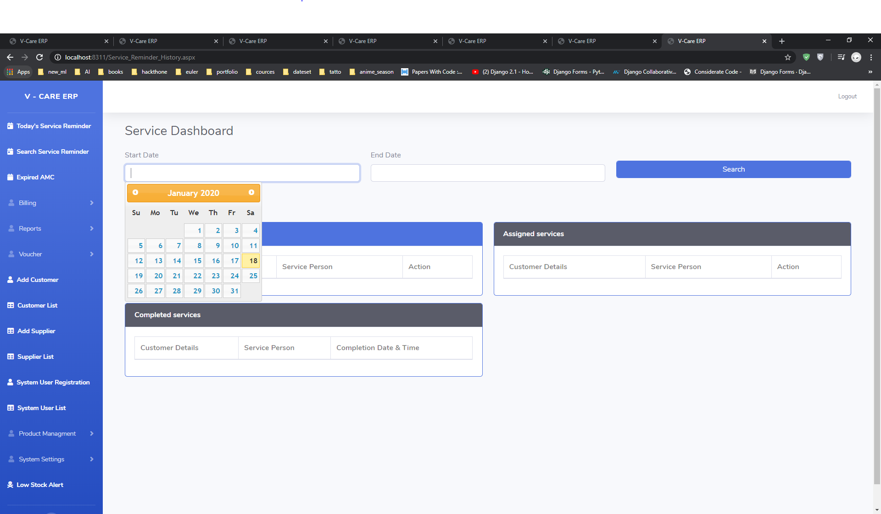

Slide 53
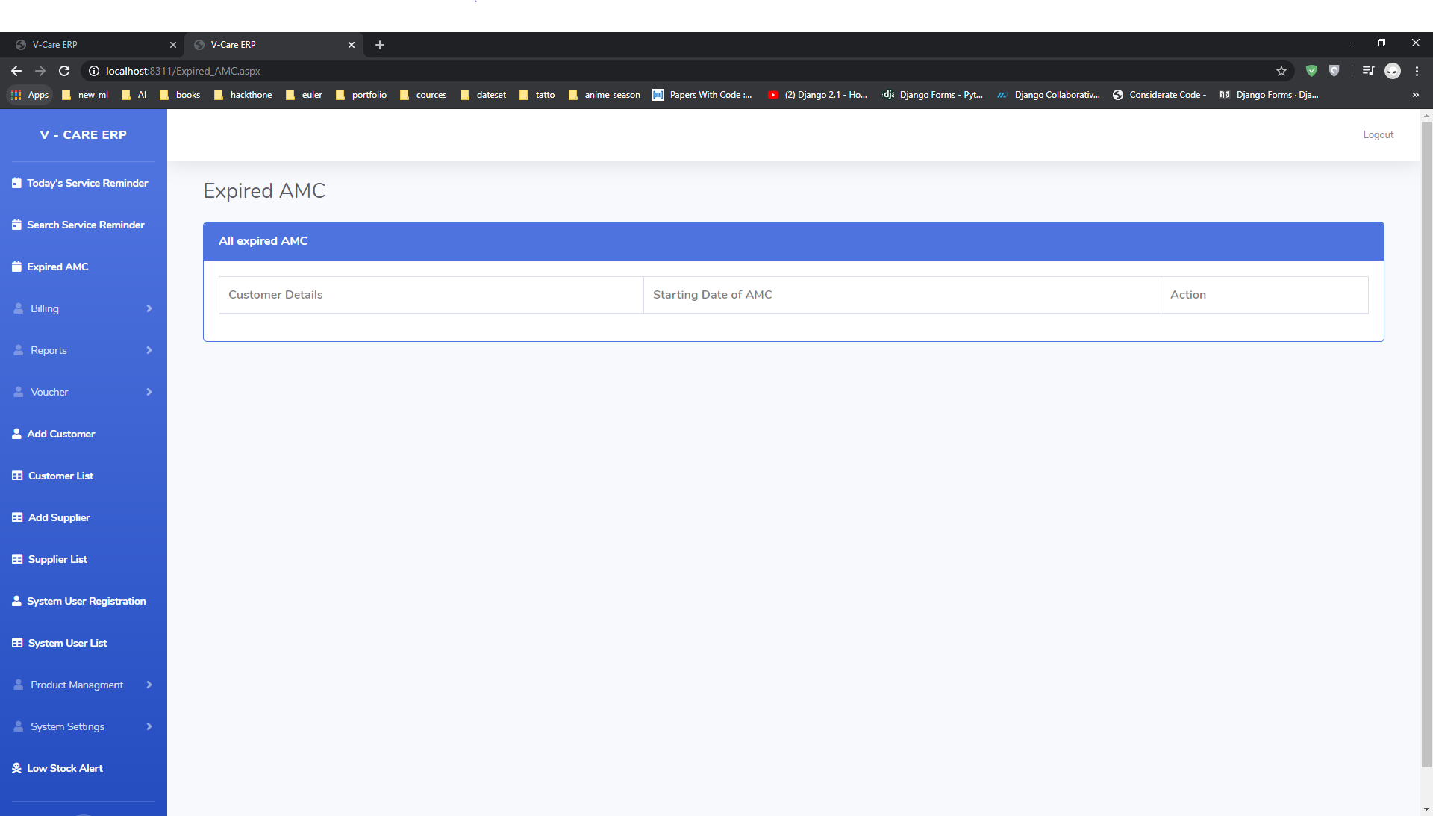

Slide 54
This pages for message service if you purchase any kind of messaging service
For your client that this can help you to send messages.
I created this project for water-purifier company.
If some how some of the purifier get damaged then one repair-man go-to client house.
For that service of client automatically provided to service-man after.

